Slide 1

Observing expert colleagues

Slide 2
Why observe expert colleagues?
This is where you will develop a lot of your understanding of how theory links to practice.
In each phase, the week-by-week plan will detail how many observations you need to do each week.
This is not a tick list, this is about observing for your own future development as a teacher.
You should be referring to these observations in your weekly review meetings and your Talk-Throughs
Don’t think you just need to sit at the back of the room and observe

Slide 3
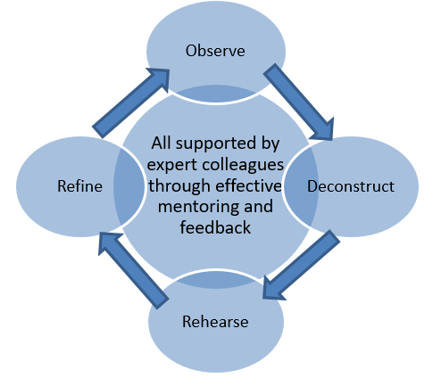
Why observe expert colleagues?
Phase 1 | Phase 2 | Phase 3
Discuss and analyse Observe and deconstruct Observe, deconstruct and begin to rehearse | Observe, deconstruct, rehearse and refine | Observe, deconstruct, rehearse, refine and justify their decisions

Slide 4
What does deconstruct mean?
Talking to your mentor
Asking questions to expert colleagues
Reading more and developing your theoretical understanding
Talking to pupils
Notes:
Jenny
Jamboard

Slide 5
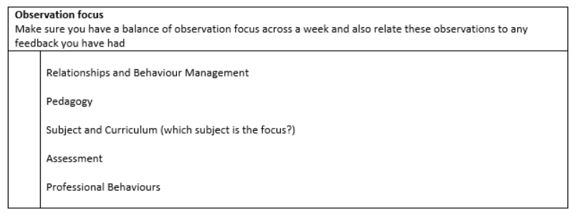
The observations form
Notes:
Jenny
Jamboard

Slide 6
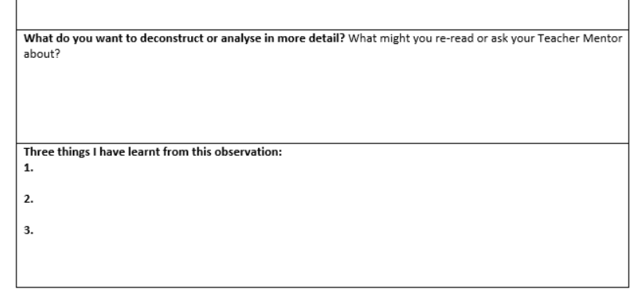
Notes:
Jenny
Jamboard

Slide 7
Observing specialists
Observing specialists in:
English
Maths
Phonics
There are separate forms to complete while observing these specialists
Invite these specialists back to observe you in your classroom

