Slide 1
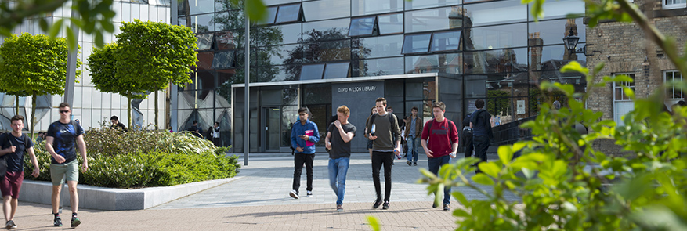

Secondary PGCE
Phase B overview
SCHOOL OF EDUCATION
Follow @Leicester_Ed on Twitter for the latest on the work of our staff and students

Slide 2
Curriculum
Phase A – Setting Foundations
Phase B – Knowing More, Doing More
The CARDs reflect this…
Notes:
We want everyone to become familiar with our curriculum – not possible to do this all in one meeting but let’s focus on one part today.

Slide 3
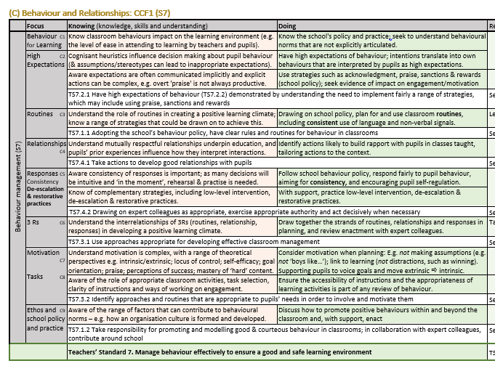
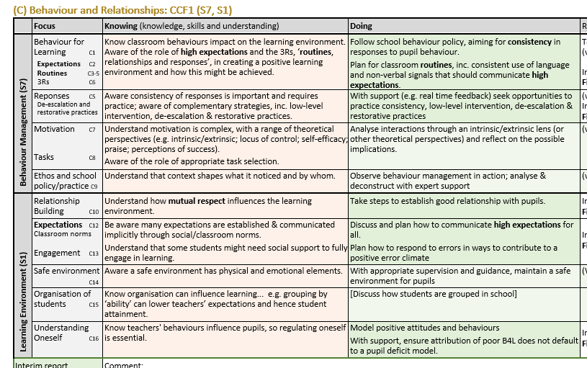
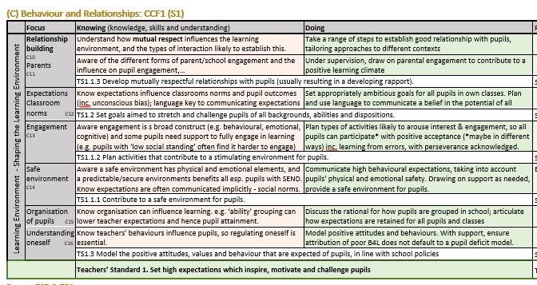
Notes:
This slide shows the change from A to B – bottom pic is Curriculum area C in Phase A, top 2 pics show how this extended and developed for Phase b
NB the Teachers’ Standards appear at the bottom of the curriculum areas for Phase B

Slide 4
Teaching timetable in Phase B
Phase A was 50% of ECT
Phase B is 66% of ECT:
PSHE in addition to their subject teaching.
Pastoral role Student teachers shadowed a form tutor during Phase A. In Phase B they need to work with a tutor group, so that they are prepared for this role in their ECT year
5 lesson day | 25 possible lessons | ECT teaches 20 | Student teaches 13
6 lesson day | 30 possible lessons | ECT teaches 24 | Student teaches15/16
8 lesson day | 40 possible lessons | ECT teaches 32 | Student teaches 21

Slide 5
Phase B
Change of school ……
Weekly email, with weekly focus
Weekly meeting
  Student Reflections, Talkthrus, Targets, Eportfolio check
Every lesson needs a lesson plan
Focused Observations/ Activities
Some flexibility/ choice

Slide 6
Assessment
Review point | What | Deadline | Who | Moderation/ QA
Week 21 (2nd week of practicum) | ‘Settling in’ report | Friday 17 February | Coordinator | Coordinator reports on how well the student has settled in
Week 27 | Interim Phase B Report | Friday 31 March | Co-tutor | SD co-tutors to ensure that SD Lead Schools are sent a copy
Week 33 | Phase B Final Report | Friday 26 May | Co-tutor | Countersigned by Coordinator; SD Mentor/Coordinators to ensure that SD Lead Schools are sent a copy
Week 36 | Student Progress Review Targeted Action Plans for identified students in need of additional support |  | University tutors | Student progress meeting

Slide 7
After Friday 26 May
If student teacher has met the Standards, they will work on transition to ECT
If not, Action Plan targeted at specific areas
Any questions, contact university tutor or SD lead.
During placement, Support Plan/Action Plan/ At Risk process if necessary

