Slide 1
Secondary PGCE Co-tutor meeting 5 October 2023

Slide 2
Welcome
Kerry Onyejekwe ko98@leicester.ac.uk Social Science Lead & School of Education AccessAbility tutor
Dr Jacob Halford jjsh2@leicester.ac.uk History and RE Lead
Shaakirah Kasuji sk1012@leicester.ac.uk Geography Lead

Slide 3
School Experience website
new
https://pgce-school-experience.le.ac.uk/

Slide 6
Agenda
Updates
Documentation: Focused Observations
ITPs
Curriculum Focus: Behaviour Management
Mentor development
NASBTT mentor resources
Professionalism and Managing Time
Questions on your role/ processes

Slide 7
Updates: documentation
Some ‘tweaks’ to documentation
CARD is now on a spreadsheet rather than a Word doc; easier to click on cells and a new Summary page captures all the key data.
Please email the whole document to secpgce (Interim and Final reports)
Students keep a pdf of the Summary sheet for Interim and Final reports in their Eportfolio
Weekly Meeting record is dated for each week and now has the Student reflection prompts on
Focused Observation sheets are now dated and have the weekly focus and the prompt on

Slide 8
Summary Sheet

Slide 9
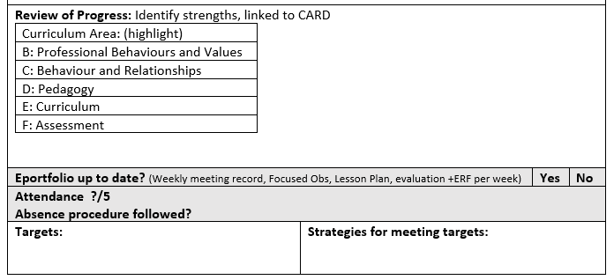
Weekly Meeting Record (bottom of sheet)
Review- identify strengths and link to curriculum
(Highlight as appropriate and add detail )
Check on record keeping and attendance
Targets for the next week
Notes:
This change has been made to encourage review of progress to cover a range of different areas and not just focus on Behaviour and Pedagogy but think about their wider progress. We have added information on eportfolio and attendance to focus on professionalism of beginning teachers.

Slide 10
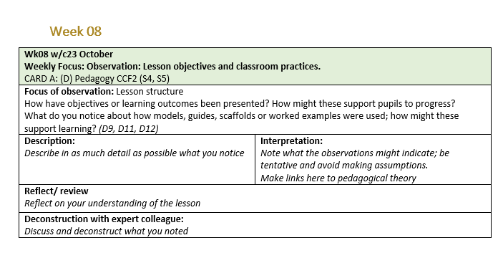
Focused Observations
Dated and titled for each week rather than a blank one to fill in
Notes:
This change is to help you as mentors understand how you are building on university sessions and delivering the curriculum.

Slide 11
Updates: Curriculum development
Intensive Training and Practice

Slide 12
ITP (Intensive Training and Practice)
Part of new DfE requirements for 2024-25
We are piloting one this year (4 will be included in 2024-25)
Focus on Behaviour and Relationships
Two days in schools, two days at university
Observe, deconstruct, analyse, rehearse, practise.

Slide 13
What is an ITP?
An opportunity to focus on one element of the curriculum and to blend theory and practice (Knowing and Doing)
This ITP will focus on Behaviour and Relationships (Curriculum area B) and Professional Values and Behaviours (Curriculum Area C)
Two days at university, two days in school in pairs
Key words: notice, observe, deconstruct, analyse, discuss, reflect, prepare, rehearse, refine and practice.

Slide 14
ITP allows students to blend theory and practice
University sessions: Behaviour and Relationships
PHASE A: Implement, rehearse
ITP: Observed routines and relationships

Slide 15
Co-tutor as curriculum deliverer
Phase A University
Phase A Placement
Phase B University
Professional and Academic
Subject days
Focused Observations
Talk Thrus
Phase B Placement
Professional and Academic
Subject Days
Focused Obserations
Talk-Thrus
CARD A
CARD B

Slide 16
Phase A: Professional and Academic
Week 1
What is the purpose of education?
What are my beliefs and values?
How do we safeguard ourselves and young people?
Week 2
How do we learn?
What is our role as educators for social justice?
How do you study Teaching and Learning?
Week 3
How do you create a positive learning environment?
How do we know what students have learnt?
How do we know students are making progress?
Week 4
How do we become inclusive teachers?
ITP Focus: How does Professional behaviour, interactions between student-teachers and pupils, and routines support learning?
Week 5
How do children and adolescents develop?
How do you engage learners?
How do you prepare for your Phase A Practicum?
Week 6
How do you fit in to the wider school?
How do you behave as a professional in a school?
Notes:
This is a summary of the curriculum.

Slide 17
Subject Days – Phase A Tuesdays (Hist, RE, Geo & Soc Sci)
Technology in the classroom
Assessment in our subjects
Dialogic Teaching
Adaptive Teaching
Planning practice day – bringing it all together!
LI’s, Task Choice and design, Assessment (AFL), progress data and adaptive teaching strategies e.g. scaffolding and targeted support
Introduction to Humanities
Explaining Humanities concepts – Practice
Principles of lesson planning
Learning intentions and success criteria
Task choice, design and engagement
Notes:
Add information on what they have covered in subject days

Slide 18
Subject Days – Phase A Thursdays: Social Science
Preparing to teach controversial and sensitive topics in the Social Sciences
Big Question teaching
Planning and teaching at GCSE and A Level in the Social Sciences
Metacognition and self-regulated learning
Observation skills
Marking and feedback
Modelling practice
Micro-teaching (subject specific)
Teaching research methods in social science (next Thursday)
Notes:
Add information on what they have covered in subject days

Slide 19
Curriculum Focus: Behaviour and Relationships
University Weeks
Sessions on Behaviour and Relationships
CARD A
Placement A
TalkThru
Focused Observation
University Weeks
Placement B
Talk thru
Reflection
ITP – Behaviour and Relationships
CARD B
Focused Observation
Reflection
Week 11 Focus
Week 33 Focus
Workshops on Routines and Relationships
Lecture: Routines, Relationships and Rules
Lecture: Motivation and Engagement
Workshop: Behaviour Management and School Policies
Notes:
Across the course topics are delivered by both university tutors and school co-tutors that build on each other.

Slide 20
Phase A - CARD
Phase B - CARD
Notes:
To show how our curriculum is delivered we can compare Behaviour and relationships to look at how it is delivered across university and schools during the year. Here is the difference between the expectations in Phase A and B in the CARD.

Slide 21
Phase A Links across course
University
Lecture and workshops with Sam Strickland
ITP focus on Routines and Relationships
Workshop: planning routines
Notes:
What they have learnt at university.

Slide 22
Week 11 Focus
Notes:
The talkthrus, focused observation and reflection all build upon this and enable you to helps students to meet the requirements for CARD A

Slide 23
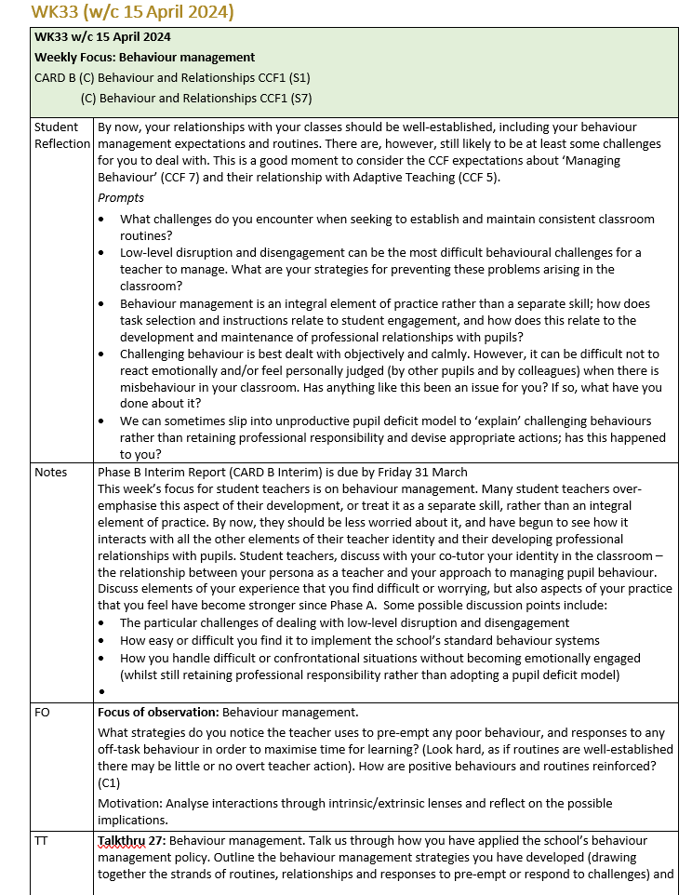
PHASE B – Links
Lecture: Routines, Relationships and Rules
Lecture: Motivation and Engagement
Workshop: Behaviour Management and School Policies
Notes:
This shows how later in Phase B it is built on in both university sessions and weekly focus.

Slide 24
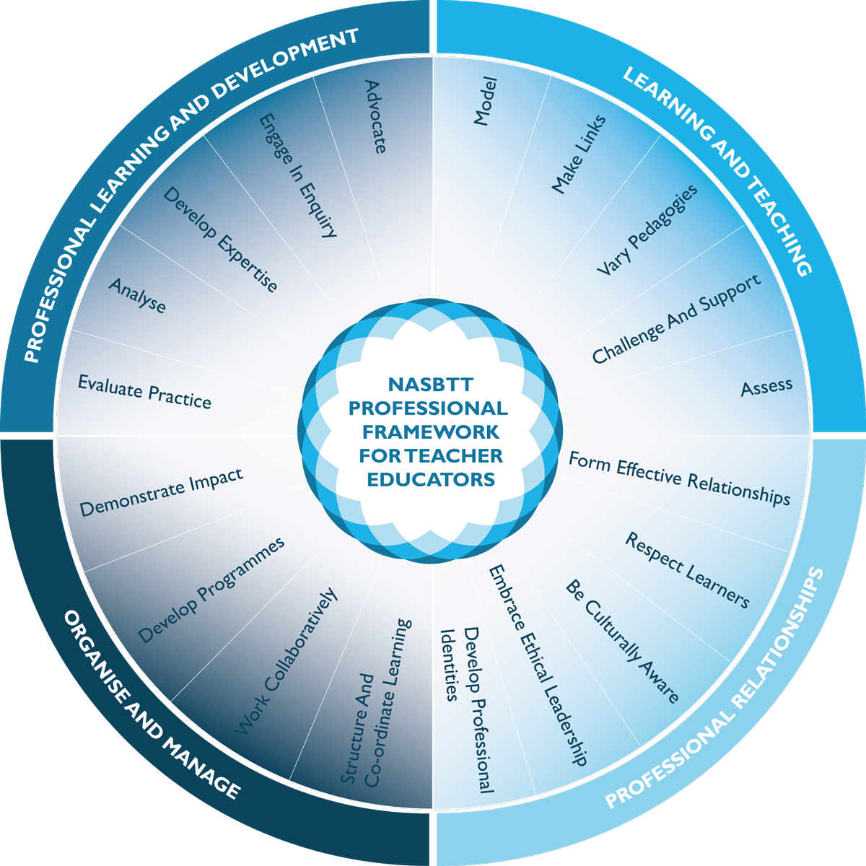
NASBTT Mentoring Resources
Notes:
NASBTT have provided a range of resources for mentors and teacher educators that are aligned with the National Mentor standards – co-tutors will either be registered already or will be sent a link so that they can access them. Each area has a short 2 page summary with 3 ideas that they can apply with their beginning teachers. There are videos and links to further reading that they can use.

Slide 25
National Mentor Standards
Standard 3 – Professionalism
Set high expectations and induct the trainee to understand their role and responsibilities as a teacher
The mentor should:
• encourage the trainee to participate in the life of the school and understand its role within the wider community;
• support the trainee in developing the highest standards of professional and personal conduct;
• support the trainee in promoting equality and diversity;
• ensure the trainee understands and complies with relevant legislation, including that related to the safeguarding of children; and
• support the trainee to develop skills to manage time effectively.
Notes:
In light of feedback from ITPs and previous cohorts we want to focus on helping beginning teachers developing professionalism and helping them to manage time. We will focus on the highlighted parts.

Slide 26
What are beginning teachers experiencing in Phase A?
Adapting to a new (unfamiliar) professional culture and relationships
Working out what kind of teacher they are
Imposter syndrome
What school is like as a teacher instead of as a student
Learning about the world - social issues (poverty, racism, sexism, deprivation)
Notes:
Discuss what beginning teachers will be experiencing in the first few weeks – in particular the fact that they most likely won’t be familiar with schools and many of the norms that are taken for granted they don’t know. What challenges does this have for you as a co-tutor? Importantly they will be experiencing school from a new perspective as a teacher – for some they will only know school from a students perspective.

Slide 27
Cultural Norms as a teacher
Richard A. Shweder defines cultural norms as:
“Cultural norms are the unwritten rules of a society, which prescribe how people should behave in different situations and prescribe what is acceptable and what is not” (1991).
How do beginning teachers know and understand your schools cultural norms?

Slide 28
What are the rules of professionalism as a teacher in your subject/department?
What are explicit? What are implicit?
What issues might a beginning teacher have at the start of Phase A in terms of professionalism and following cultural norms in your school?
How can you as a co-tutor help to introduce beginning teachers to your professional community?
Notes:
Draw on experienced mentors to help them to identify what beginning teachers might need to know or might not be aware of about professionalism. Norms around use of staff room, photocopying, eating lunch, etc. Timing, communication, absence etc.

Slide 29
How do we support beginning teachers' time management?
How do you ensure that the focused observation happens each week?
“Allow your mentee to observe a variety of teaching styles across as many contexts as possible. Including cross phase observations, working in different year groups etc”
How do you help them to make effective use of their planning and preparation time?

Slide 30
 | 1 | 2 | 3 | 4 | 5
Monday | Plan for Thur p1 | Teach from week 2 | Focused Observation | Plan for Thur p3
Tuesday | Prepare reflections |  |  | Mentor Meeting
Wednesday |  |  | Teach from Week 1
Thursday |  |  |  | Teach from Week 1
Friday |  | Teach from week 2
Notes:
Supporting beginning teachers by directing them in how to use their time. Use the timetable to block out timing to plan for lessons – don’t assume that they know how to prioritise and plan effectively. Put in time for a focused observation on their timetable remember these can be across any area of the school and would be good to get students to observe as many different teachers and subjects as possible.

Slide 31
Questions?

