Slide 1
Phase 2 Planning and assessment in foundation subjects
Ben Harvey-Ashenhurst

Slide 2
Assessment in foundation subjects
Notes:
Jenny

Slide 3
What are you assessing?
Curriculum coverage
Working towards / working at / greater depth
Knowledge retention
Skills development

Slide 4
Learning vs performance
Curriculum coverage

Slide 5
Learning vs performance
Learning is not about how busy the children are
A successful lesson might not be that the children are just ‘busy’
It is about the knowledge and skills they are retaining

Slide 6
Learning vs Performance
‘Be explicit with your students that they will need to know the material you are teaching them later and spell out exactly what they need to remember and practise.’
https://my.chartered.college/wp-content/uploads/2018/08/LearningvPerfomance.pdf

Slide 7
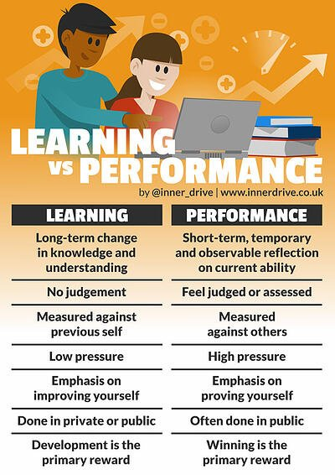
https://blog.innerdrive.co.uk/learning-vs-performance

Slide 8
Working towards / met / greater depth

Slide 9
Making more work for ourselves
‘To understand tint and tone using it through practical experiences.’
What does that look like for a child working towards, working at and greater depth

Slide 10
What are you assessing?
Do the children know more?
Can they remember more?
Can they do more?

Slide 11
Examples of assessment in art
National Curriculum for KS1
to use drawing, painting and sculpture to develop and share their ideas, experiences and imagination
to develop a wide range of art and design techniques in using colour, pattern, texture, line, shape, form and space
about the work of a range of artists, craft makers and designers, describing the differences and similarities between different practices and disciplines, and making links to their own work.
Will lead to a sequence of teaching with the following learning intention:
- To use drawing to share ideas and experiences using a techniques of line, shape and form in the style of LS Lowry.
Notes:
Can we draw out the difference between knowledge and skills here?

Slide 12
Examples of assessment in art
At the start of the teaching:
‘Show me all the different ways you can use a pencil to draw something’
‘Tell me what you know about LS Lowry’

Slide 13
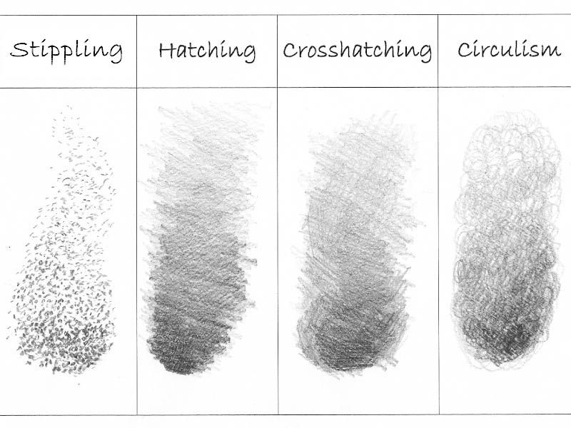
Examples of assessment in art
Teaching
what formative assessment techniques might you use?
what do you need to track?

Slide 14
Examples of assessment in art
At the end of the unit of teaching:
‘Show me all the different ways you can use a pencil to draw something’
‘Tell me what you know about LS Lowry’
Children produce a finished product

Slide 15
Examples of assessment
- Essay
Double page spread report
Piece of artwork
Finished design project
Podcast
Video
Performance
Kahoot! Quiz
As long as the children can demonstrate they know more, can remember more and do more.

Slide 16
Low Stake vs. High Stake Assessment
Notes:
In low-stakes assessments, such as quizzes and surveys, the consequences to the candidate are low, and so the legal liabilities are low. These assessments are often taken alone since there isn’t any motivation to cheat or share answers with others. Little planning is required: subject matter experts (SMEs) simply write the questions and make them available to learners. The consequences of low-stakes tests are easily reversed. If someone gets a poor score on a quiz, for instance, they could improve their score on a retake. But what about the consequences of a high-stakes test, such as a nursing certification exam? It would very difficult, if not impossible, to reverse the consequences of failing such a test. This kind of test, therefore, requires a great deal of planning. This might include job task analysis, setting pass/fail scores, specifying the methods and consistency of delivery required, and determining how results will be stored and distributed.

Slide 17
Metacognition
Notes:
Cognition is the mental process involved in knowing, understanding, and learning. By cognitive strategies, we mean skills like memorisation techniques or subject-specific strategies like making different marks with a brush or using different methods to solve equations in maths. This is the bread and butter of good teaching; cognitive strategies are fundamental to acquiring knowledge and completing learning tasks.
Metacognition is about the ways learners monitor and purposefully direct their learning. For example, having decided that a particular cognitive strategy for memorisation is likely to be successful, a pupil then monitors whether it has indeed been successful and then deliberately changes (or not) their memorisation method based on that evidence. By metacognitive strategies, we mean the strategies we use to monitor or control our cognition, such as checking that our memorisation technique was accurate or selecting the most appropriate cognitive strategy for the task we are undertaking.
Motivation is about our willingness to engage our metacognitive and cognitive skills and apply them to learning. Motivational strategies will include convincing oneself to undertake a tricky revision task now—affecting our current well-being—as a way of improving our future well-being in the test tomorrow
Cognition, metacognition, and motivation all interact in complex ways during the learning process. For Freya, she deployed cognitive strategies, like using mnemonics and doing some self-testing practice at home. She used metacognitive strategies to plan her spelling practice, recognising why using a mnemonic was the right tool for the job, while monitoring her own difficulties with time pressures during the test. Finally, Freya mustered the motivational strategies to engage in repeated practice and to persevere during a pressured challenge.
https://d2tic4wvo1iusb.cloudfront.net/eef-guidance-reports/metacognition/EEF_Metacognition_and_self-regulated_learning.pdf

Slide 18
Examples of metacognition
Planning:
‘What resources do I need to carry out a self-portrait?’
‘Have I done a self-portrait before and was it successful?’
‘What have I learned from the examples we looked at earlier?’
‘Where do I start and what viewpoint will I use?’
‘Do I need a line guide to keep my features in proportion?’
Notes:
Motivation is about our willingness to engage our metacognitive and cognitive skills and apply them to learning. Motivational strategies will include convincing oneself to undertake a tricky revision task now—affecting our current well-being—as a way of improving our future well-being in the test tomorrow
Cognition, metacognition, and motivation all interact in complex ways during the learning process. For Freya, she deployed cognitive strategies, like using mnemonics and doing some self-testing practice at home. She used metacognitive strategies to plan her spelling practice, recognising why using a mnemonic was the right tool for the job, while monitoring her own difficulties with time pressures during the test. Finally, Freya mustered the motivational strategies to engage in repeated practice and to persevere during a pressured challenge.
https://d2tic4wvo1iusb.cloudfront.net/eef-guidance-reports/metacognition/EEF_Metacognition_and_self-regulated_learning.pdf

Slide 19
Examples of metacognition
Monitoring:
‘Am I doing well?’
‘Do I need any different techniques to improve my self-portrait?’
‘Are all of my facial features in proportion?’
’Am I finding this challenging?’
‘Is there anything I need to stop and change to improve my self-portrait?’
Notes:
Cognition is the mental process involved in knowing, understanding, and learning. By cognitive strategies, we mean skills like memorisation techniques or subject-specific strategies like making different marks with a brush or using different methods to solve equations in maths. This is the bread and butter of good teaching; cognitive strategies are fundamental to acquiring knowledge and completing learning tasks.
Metacognition is about the ways learners monitor and purposefully direct their learning. For example, having decided that a particular cognitive strategy for memorisation is likely to be successful, a pupil then monitors whether it has indeed been successful and then deliberately changes (or not) their memorisation method based on that evidence. By metacognitive strategies, we mean the strategies we use to monitor or control our cognition, such as checking that our memorisation technique was accurate or selecting the most appropriate cognitive strategy for the task we are undertaking.
Motivation is about our willingness to engage our metacognitive and cognitive skills and apply them to learning. Motivational strategies will include convincing oneself to undertake a tricky revision task now—affecting our current well-being—as a way of improving our future well-being in the test tomorrow
Cognition, metacognition, and motivation all interact in complex ways during the learning process. For Freya, she deployed cognitive strategies, like using mnemonics and doing some self-testing practice at home. She used metacognitive strategies to plan her spelling practice, recognising why using a mnemonic was the right tool for the job, while monitoring her own difficulties with time pressures during the test. Finally, Freya mustered the motivational strategies to engage in repeated practice and to persevere during a pressured challenge.
https://d2tic4wvo1iusb.cloudfront.net/eef-guidance-reports/metacognition/EEF_Metacognition_and_self-regulated_learning.pdf

Slide 20
Examples of metacognition
Evaluation:
‘How did I do?’
‘Did my line guide strategy work?’
‘Was it the right viewpoint to choose?’
‘How would I do a better self-portrait next time?’
‘Are there other perspectives, viewpoints or techniques I would like to try?’
Notes:
Cognition is the mental process involved in knowing, understanding, and learning. By cognitive strategies, we mean skills like memorisation techniques or subject-specific strategies like making different marks with a brush or using different methods to solve equations in maths. This is the bread and butter of good teaching; cognitive strategies are fundamental to acquiring knowledge and completing learning tasks.
Metacognition is about the ways learners monitor and purposefully direct their learning. For example, having decided that a particular cognitive strategy for memorisation is likely to be successful, a pupil then monitors whether it has indeed been successful and then deliberately changes (or not) their memorisation method based on that evidence. By metacognitive strategies, we mean the strategies we use to monitor or control our cognition, such as checking that our memorisation technique was accurate or selecting the most appropriate cognitive strategy for the task we are undertaking.
Motivation is about our willingness to engage our metacognitive and cognitive skills and apply them to learning. Motivational strategies will include convincing oneself to undertake a tricky revision task now—affecting our current well-being—as a way of improving our future well-being in the test tomorrow
Cognition, metacognition, and motivation all interact in complex ways during the learning process. For Freya, she deployed cognitive strategies, like using mnemonics and doing some self-testing practice at home. She used metacognitive strategies to plan her spelling practice, recognising why using a mnemonic was the right tool for the job, while monitoring her own difficulties with time pressures during the test. Finally, Freya mustered the motivational strategies to engage in repeated practice and to persevere during a pressured challenge.
https://d2tic4wvo1iusb.cloudfront.net/eef-guidance-reports/metacognition/EEF_Metacognition_and_self-regulated_learning.pdf

Slide 21
Metacognition in Phase 2
A Phase 2 expectation is to be able to:
- identify opportunities where expert colleagues have guided pupils to reflect on their progress (metacognition)
This is a really important element of further developing your planning and assessment in all subjects. You should tune into this as part of your observations of expert colleagues. This will be picked up further in the Phase 2 de-brief and will be something you will be expected to include within your Phase 3 sequences of lessons.

Slide 22
Metacognition in action
Use of success criteria
Planned questioning across the process
Use of feedback (teacher, peer and self)

Slide 23
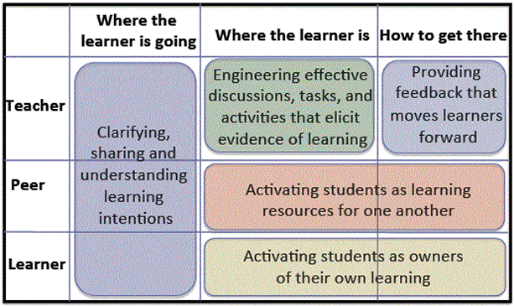
What are the principles of assessment for learning?
Dylan Wiliam – 5 key strategies for formative assessment
www.nwea.org/blog/2013/dylan-wiliam-unpacking-formative-assessment/
Notes:
Introduce this model by Wiliam which he uses to articulate the strategies for formative assessment.
Take ideas of different formative assessment strategies they have seen in their prelim placement. Which box do they fit in? Can they see examples of all boxes?
Introduce the idea that it is not as straight-forward as putting strategies in boxes and just using one strategy at a time. It is about being responsive and always deciding what instructional decisions are made to move the learning forward.
For more information: Wiliam, D. (2011) Embedded Formative Assessment. Bloomington: Solution Tree Press,

Slide 24
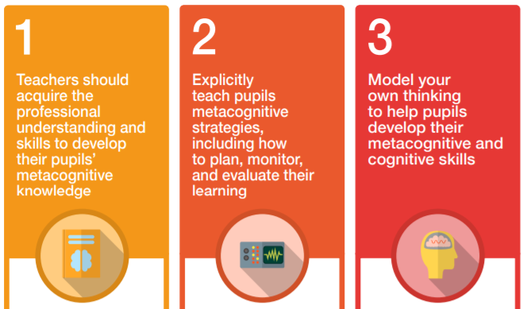
Metacognition in action

Slide 25
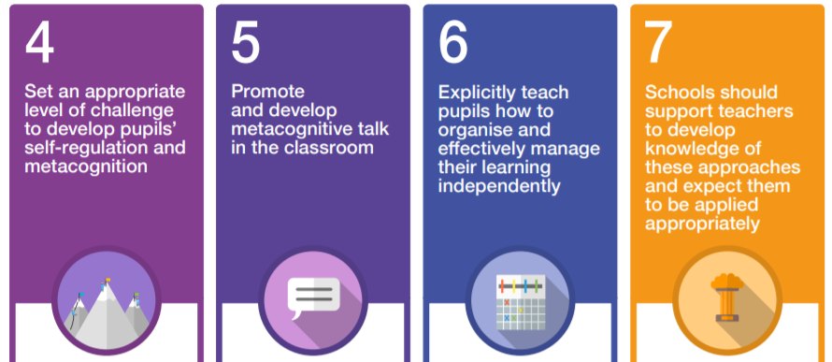
Metacognition in action

Slide 26
Marking in foundation subjects
High quality feedback is purposeful, encourage further effort and should be acted upon by children
When is the best time to give verbal or written feedback during foundation subject and science teaching?

Slide 27
What are you assessing?
Curriculum coverage over time
Working towards / working at / greater depth
Knowledge retention over time
Skills development over time
Who is assessing?

Slide 28
When you are assessing be aware of…
Where does it fit within the curriculum
How you might respond to assessment from previous units
What are key knowledge and skills the children need to learn
How much they have retained this information
How much they are completing a skill independently
How much they are reflecting on their own progress

Slide 29
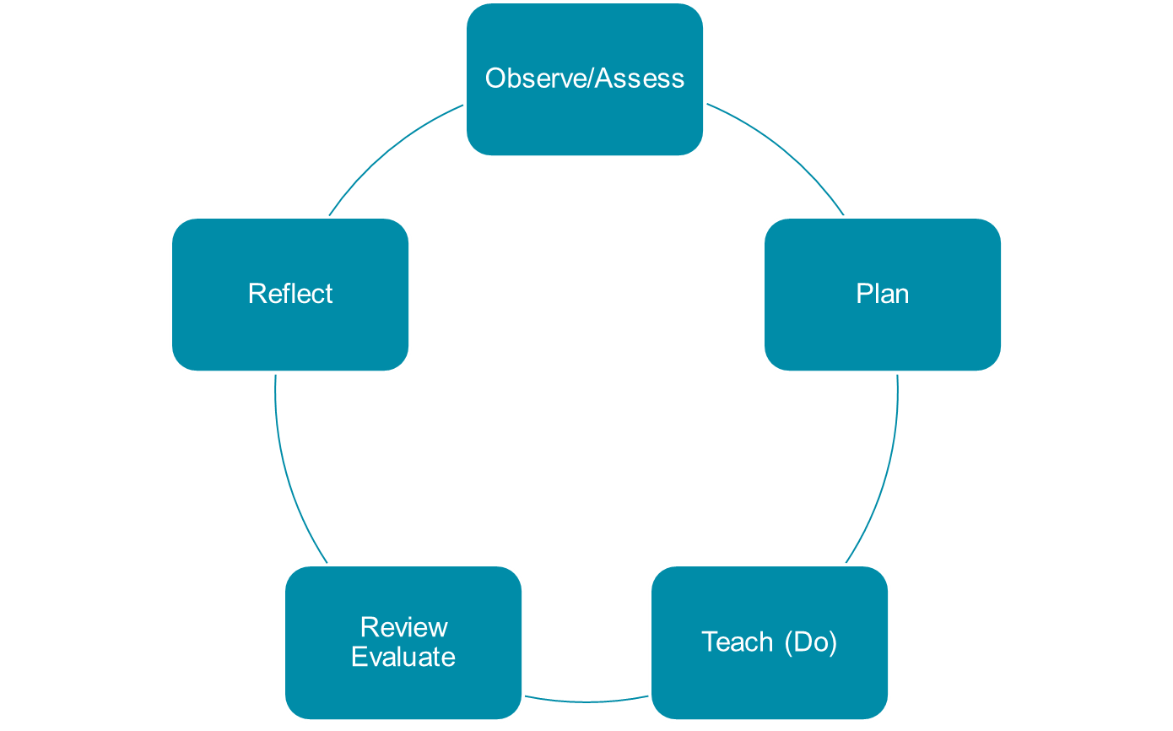
Planning and assessment
What do you need to consider when planning and assessing in the foundation subjects?
What does planning look like within the planning cycle?
What does assessment look like (between lessons and a finished outcome)?
How might you develop your understanding of metacognition?

Slide 30
Become ‘au fait’ with your phase 2 school marking policy
To end this session, find your phase 2 school’s marking policy
If you cannot find it – make sure you ask your mentor for a copy
Take time to establish: How the subjects are assessed, how the children receive feedback, the frequency of this (per lesson/alternate), completed by the teacher/assistant/child?

