Slide 1
Primary PGCE Mentor training 19th January 2024

Slide 2
What we will cover:
1) The mentoring role
2) The University of Leicester curriculum and assessment
3) SMART Targets and PDF input
4) Expectations for Phase 2 for trainees
5) Review the PD cycle and key messages

Slide 3
Who’s who?
pripgce@le.ac.uk
pgcepartnership@le.ac.uk
Professional services:
Austin Ruddy
Dan Lathbury Krissie Martin
Patrick Dudley
Mei Zheng (Business operations manager)
Yvonne Lee (Operations manager)
Neha George (School administrator)
Tutors:
Jenny Bosworth
Fiona Curtis
Marianne Quinsee
Ben Harvey-Ashenhurst
Mandy Fieldsend
Keith Culverwell

Slide 4
Mentoring
National Mentor Standards

Slide 5
What are the rules of professionalism as a teacher in your school?
What are explicit? What are implicit?
What issues might a beginning teacher have at the start of Phase 2 in terms of professionalism and following cultural norms in your school?
How can you as a mentor help to introduce beginning teachers to your professional community?
Notes:
Draw on experienced mentors to help them to identify what beginning teachers might need to know or might not be aware of about professionalism. Norms around use of staff room, photocopying, eating lunch, etc. Timing, communication, absence etc.

Slide 6
National Mentor Standards
Standard 3 – Professionalism
Set high expectations and induct the trainee to understand their role and responsibilities as a teacher
The mentor should:
• encourage the trainee to participate in the life of the school and understand its role within the wider community;
• support the trainee in developing the highest standards of professional and personal conduct;
• support the trainee in promoting equality and diversity;
• ensure the trainee understands and complies with relevant legislation, including that related to the safeguarding of children; and
• support the trainee to develop skills to manage time effectively.
Notes:
Should slides 31 - 37 come earlier – at the beginning?

Slide 7
Traditional vs Educative mentoring
Mentors show their mentees plans for scrutiny – ‘Here is my lesson plan, now write your own’
Educative mentors co-plan collaboratively making thoughts and discussions explicit
‘Watch me, now you do that.’
Did you notice… Why do you think I did that?
You did…. and this happened. You could have…
Did you notice… What does that tell us? What might we do instead?
I have seen… Therefore, I think you are working towards…
How well do you think you are getting on with this? Where is it still challenging for you?
Notes:
The practices
Co-planning with a focus on learning goals and pupil need – ‘us’ and ‘we’
Based on growth, continuity and inquiry
Continuous articulation of thoughts, questions and decisions
Probe student teacher thinking to pinpoint, and address, problems (Feiman-Nemser, 2001b)
Prepare students to become independent decision makers
Use of evidence to analyse pupil learning while helping the student to learn from their teaching
Focussed feedback using supporting evidence (Hudson, 2014; Valencia et al, 2009)
Encouragement of professional discourse about teaching & learning and reflection

Slide 8
One model for your weekly meetings/ feedback/ professional discussions The three Es of Questioning
Establish
Expand
Explore
With thanks to Haili Hughes

Slide 9
Establish: ‘to initiate, bring about, introduce’
Tell me about..
What happened when..
What did you do..
What made you think that..
What are your goals?
Why would you chose that (method/task)..
Making pedagogical decisions visible; important to listen to the student teacher to understand how they are thinking

Slide 10
Expand: ‘to open up, unfold, express in greater detail, make more extensive’
What is another way you might..
What do you think would happen if…
What needs to change in order to…
Explain what you mean by..
How important is it to you to..
What other approaches have you considered?

Slide 11
Explore: to search, probe, examine, to explore relationships between’
What will support you in making changes?
How might your assumptions about...have influences how you are thinking about…
What evidence do you have?
What do you need to make the changes you want?
How willing are you to change from what you have been doing?

Slide 12
Discussion:
Do you find this idea of 3 Es of questions helpful?
Experienced mentors: Can you share any experiences from your post lesson feedback or weekly meetings last year?
What were the main challenges?

Slide 13
What will our trainees experience in Phase 2?
Adapting to a new professional culture and relationships
Developing and understanding the kind of teacher they are
Now knowing what they don’t know!
Understanding their impact on the world - social issues (poverty, racism, sexism, deprivation)
Now the sole trainee within their classroom
Notes:
Should this be earlier?
Does it need to make the general expectations clearer – add in the flow diagram with the weekly overview.
Discuss what beginning teachers will be experiencing in the first few weeks – in particular the fact that they most likely won’t be familiar with schools and many of the norms that are taken for granted they don’t know. What challenges does this have for you as a co-tutor? Importantly they will be experiencing school from a new perspective as a teacher – for some they will only know school from a students perspective.

Slide 14
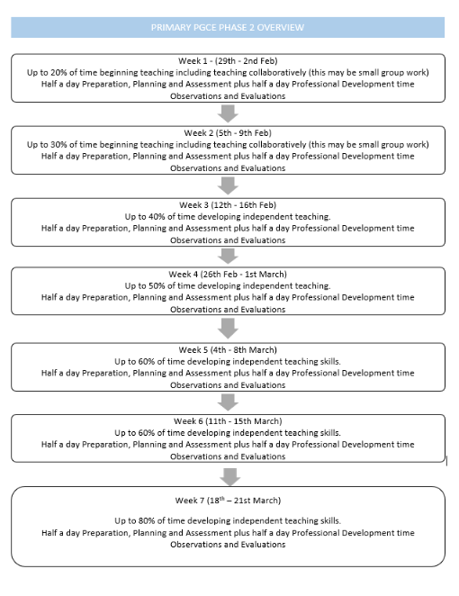
Notes:
Maybe this is needed?

Slide 15
School Experience website
new
https://pgce-school-experience.le.ac.uk/

Slide 17
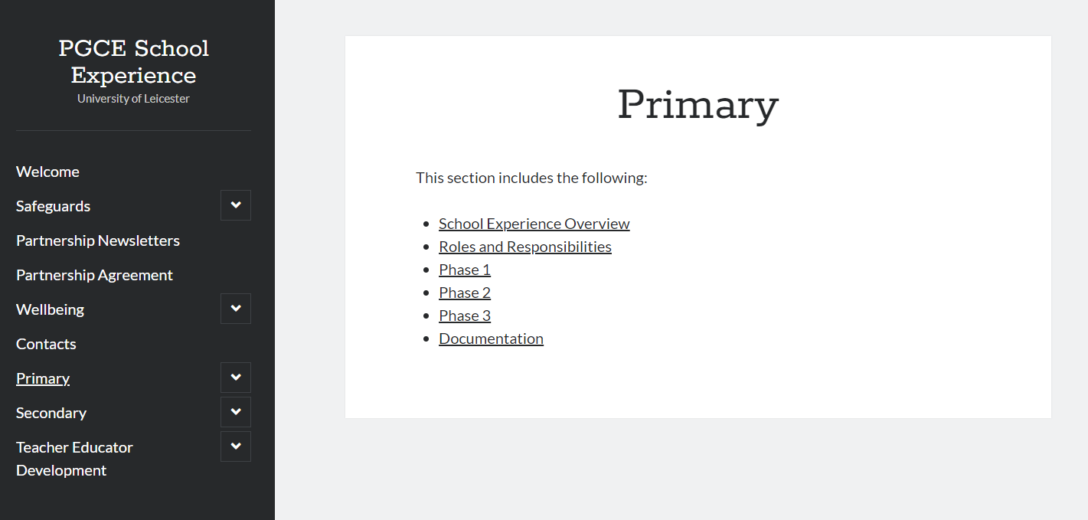

Slide 18
Being a mentor with The University of Leicester
Our curriculum intent and underpinning principles
Our development cycle
Our assessment processes

Slide 19
Purposeful Integration
The PGCE course is designed with knowledge and skill development, in combination with practical application and reflective practice
Three distinct teaching phases allow for the trainee’s understanding of the expectations, and their own progress towards these, to develop
Notes:
Jenny

Slide 20
Our ITE curriculum is developed around the statements of the CCF and embedded alongside this are the principles of ‘knowing, doing and being’ (Craig, 2018).
Knowing - The complex and interrelated body of knowledge for teaching and ways of thinking, such as creativity and criticality.
Doing The multifaceted skills and practices involved in teaching.
Being Self-awareness that establishes professional identity and responsibilities, and the reflexive relationships with others.
Through the PGCE course trainees will reflect on their progress with the developing understanding of what teachers know (subject and pedagogical knowledge), what they do (the skills involved) and how they will develop as an effective practitioner, with your support and guidance as an expert colleague.

Slide 21
Knowing
‘Learn that’ statements from the Core Content Framework
Does not change from phase-to-phase
Will need to be assessed in some taught sessions and end of each phase to ensure the knowledge students have about teaching and learning is secure and built upon
Phase 1 – ‘introduced to’
Phase 2 – ‘introduced to’ and ‘further develop’
Phase 3 – ‘show confidence in’

Slide 22
Doing
‘Learn how to’ statements from the Core Content Framework
The school-based tasks in each phase will be aligned with the expectations
Phase 1 ‘Task manager’ | Phase 2 ‘Curriculum deliverer’ | Phase 3 ‘Concept/ skill builder’
Discuss and analyse Observe and deconstruct Observe, deconstruct and begin to rehearse | Observe, deconstruct, rehearse and refine | Observe, deconstruct, rehearse, refine and justify their decisions

Slide 23
Being
Reflective questions on the prompt cards can support mentors and trainees
Talk-throughs are chosen by the trainee to allow them to reflect upon their own development
During each weekly review meeting the chosen Talk-through will be addressed which will draw out key aspects of the trainee’s understanding
Notes:
May take different forms but preparation is expected

Slide 24
Development cycle
Phase 2
Observe, deconstruct and begin to rehearse and refine
Notes:
Jenny
Jamboard

Slide 25
Curriculum and Assessment

Slide 26
The role of the Teachers’ Standards
Teachers’ Standards are
used to support summative judgements
to be consistently met by a student to be recommended for QTS at the end of the course at a developmentally appropriate level
Teachers’ Standards are not
to be used by mentors and tutors to assess observations or to give feedback
to be used too early within a course to summatively assess trainees

Slide 27
University Assessment 3: Reflective Practice
Key reflective questions
Relationships and Behaviour Management
How do your relationships and expectations in a primary classroom support children’s learning?
Pedagogy
How can your understanding of equality, diversity and inclusion enhance the opportunities for all learners to make progress?
Subject and Curriculum
What contribution does the notion of cultural capital within the broader curriculum make to children’s health, wellbeing and wider development?
Assessment
How do Assessment for Learning (AfL) strategies support your monitoring and evaluation of pupils’ learning?
Professional Behaviours
How has your understanding of your ‘professional teacher identity’ developed?
Notes:
Explain that most students will be completing UA3 – due on 5th April. This is a reflective journal and they will draw on the work done via their Talk-throughs. Useful questions and prompts are available on the prompt cards to support.

Slide 28
Updates: documentation
Curriculum assessment and review document (CARD)
Weekly review and target setting record (+ Talk-throughs)
Prompt cards as supporting documents

Slide 29
Curriculum Assessment and Review Document (CARD 2)
Makes strong links between the university sessions (knowing) and the school-based practicum (doing) to form a basis for assessment (being)
Summarises our curriculum over the three phase CARDs
Brings together the academic and professional elements of the PGCE course
A developmental tool by which to monitor understanding and progress
Notes:
Is this info needed?

Slide 30
Assessment of Knowing and Doing – CARD 2
These will form a significant part of the end of phase comments from the mentors
We will want to know from the mentors and the trainees if they are ‘secure’ or ‘not yet secure’
This will assess the trainee’s understanding and how they have integrated what they ‘know’ and what they can now ‘do’
Working through each phase, we will see the trainee’s knowing more, remembering more, doing more and understanding more

Slide 31
Notes:
NOTE: This is a P1 Card!

Slide 32
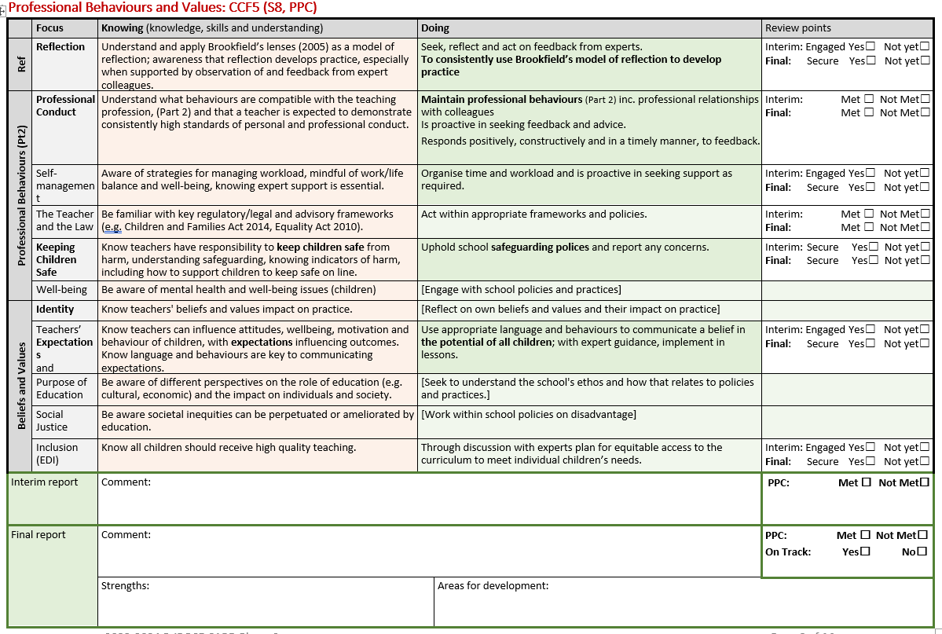
University sessions have covered…
School-based learning should include…
Assessment during and at the end of P2

Slide 33
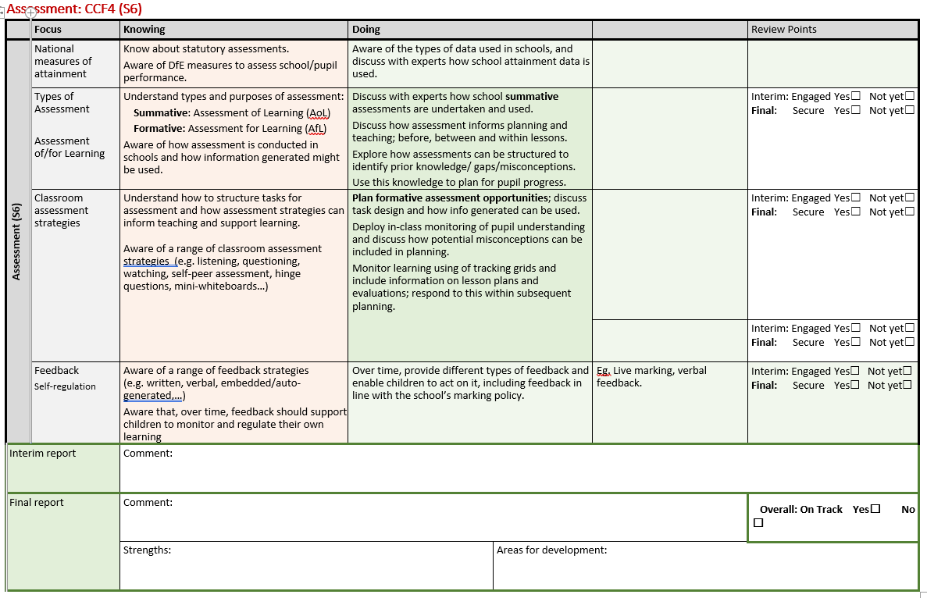
University sessions have covered…
School-based learning should include…
Subject specific context to consider…
Assessment during and at the end of P2

Slide 34
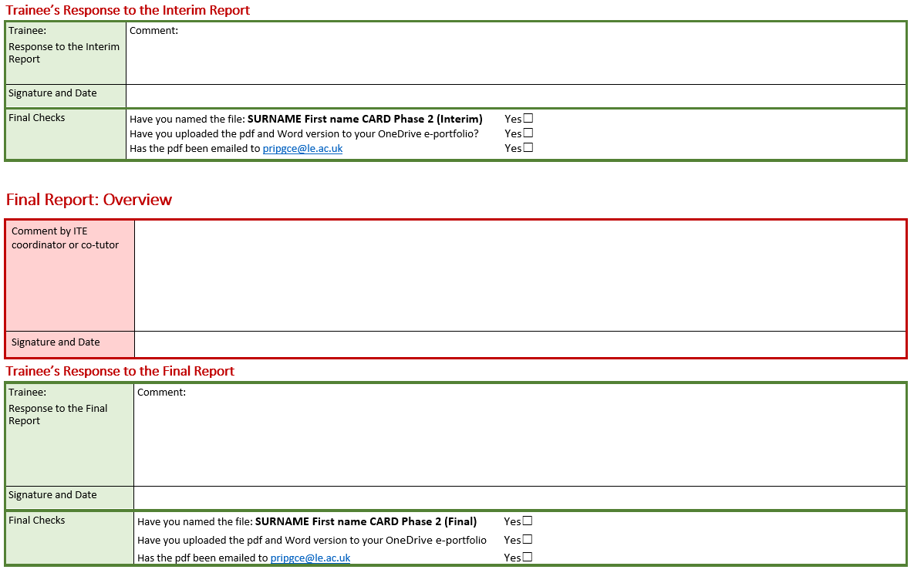
Assessment at the end of P2

Slide 35
Professional Development Cycle
Observations of teachers/children/tracking grids
Lesson/Activity plans
Observe/Assess
Plan
Teach/Do
Evaluate/
Review
Set Targets (PDF)
Reflect
Weekly Review
Feedback and Lesson observations
CARD 2
Lesson/activity plans
Lesson Evaluations
Feedback and Lesson observations
Notes:
Is this any use?

Slide 36
Mid-Phase Moderation Meeting
Wednesday 14th February 1 – 4pm

Slide 37
Target setting

Slide 38
Model for Setting Targets
S-Specific M – Measurable A – Attainable R – Realistic T – Time Related
Verb What is to be done | Object What/whom | Result What outcome will be achieved
To use … | …quickly address low level off task behaviours using the school’s/class behaviour policy… | ..so children’s learning time is maximised and expectations reinforced.
To model… | …the schools agreed calculation policy… | …so that a consistent approach is adopted.
To provide…. | …clear LO and SC to the children… | ...so children know what they are learning and how to achieve this.
To deploy.. | …additional adults in the room to support the learning of target children.. | …so children are provided additional input to aid their progression.

Slide 39
Target setting – SMART
Target 1 | Target 2 | Target 3 | Target 4
Increase the pace of the lesson | Think about your questioning | Manage low level disruption | Develop use of attention grabbers

Slide 40
Professional Development Focus
Comes from:
Weekly review target
Lesson observation informal/formal feedback
A consideration pertinent to a particular lesson your trainee is teaching e.g. ensuring equipment is set up safely for P.E.
Within a lesson there should be evidence that they are making progress towards meeting their PDF.
Targets need to be smart (specific, measurable, achievable, realistic and time bound).

Slide 41
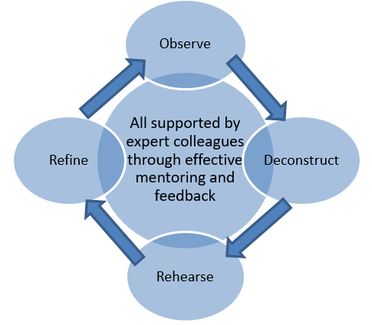
Professional Development Focus (PDF)
How the professional development focus emerged
Where it demonstrates how this was addressed during the lesson
Where they have observed you as their mentor in relation to this PDF
Was this an effective PDF? Why?

Slide 42
Directed Tasks

Slide 43
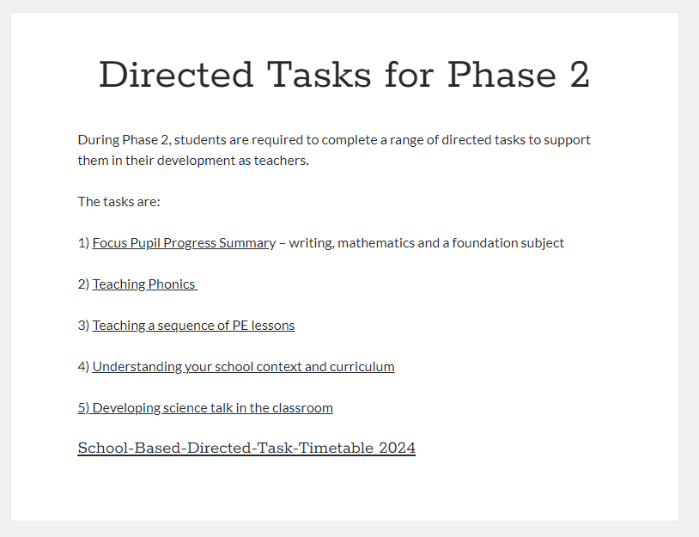
https://pgce-school-experience.le.ac.uk/directed-tasks-for-phase-2/

Slide 44
The details!
The university-led students’ personal tutor will visit twice during phase 2
School direct students will have one visit from their personal tutor and one from their SD lead
You will receive a ‘Friday email’ each week to summarise the expectations for the following week
You should aim to formally observe and feedback to your trainee once a week but you will also have informal professional discussions throughout the placement
The CARD should form part of your weekly review meetings and support you and your trainee in tracking progress and setting targets

Slide 45
When to raise concerns
Is the trainee behaving consistently and to a high standard to the personal and professional conduct element of Part 2 of the standards?
Are they meeting your expectations of what is outlined for this stage of their development?
Are they meeting your expectations for progress within the professional development cycle, from your observations, weekly reviews and discussions?
If not:
Speak to your Visiting Tutor when they visit/ make contact
If you have serious concerns, email your Visiting Tutor and they will discuss the next stage of the support process with you
If your concerns relate to Part 2, contact your Visiting Tutor immediately
Notes:
Show the appropriate section on the SE website – has this been updated?

Slide 46
What does the CCF say?
Discussing and analysing with expert colleagues: Interrogate with an expert colleague – using the best available evidence – what makes a particular approach successful or unsuccessful, reflecting on how this approach might be integrated into the trainee’s own practice.
Observing how expert colleagues … and deconstructing this approach: Working with expert colleagues – using the best available evidence – to critique a particular approach – whether using in-class observation, modelling or analysis of video – to understand what might make it successful or unsuccessful.
Receiving clear consistent and effective mentoring: Receiving structured feedback from expert colleagues on a particular approach – using the best available evidence – to provide a structured process for improving the trainee’s practice.

Slide 47
Ofsted updates
SEND focus
Making the links between university sessions and school-based learning
Core content embedded through both – ‘purposeful integration’

Slide 48
Professional Development Cycle
Observations of teachers/children/tracking grids
Lesson/Activity plans
Observe/Assess
Plan
Teach/Do
Evaluate/
Review
Set Targets (PDF)
Reflect
Weekly Review
Feedback and Lesson observations
CARD 2
Lesson/activity plans
Lesson Evaluations
Feedback and Lesson observations
Notes:
Is this any use?

Slide 49
Questions?
1) The mentoring role
2) The University of Leicester curriculum and assessment
3) SMART Targets and PDF input
4) Expectations for Phase 2 for trainees
5) Review the PD cycle and key messages
Thank you!
See you on 14th February

