Slide 1
Assessing learning in reading
The aim of this directed task is to build a rich picture of the reading experiences and competence of your three focus children, working towards, at and at greater depth in relation to age-related expectations, and your focus child with SEND.
This knowledge will inform your focus children’s progress meetings (week 4) and begin to inform your planning of next steps in learning for those individuals, groups or the whole class during the final weeks of your placement.

Slide 2
There are four steps to follow
Some of these require you to make your own observations of the focus children, while others require you to engage in reading with the children yourself.
It may be useful to arrange for someone to observe this process in order to make detailed notes and to share in discussion afterwards. For most students this will be your placement partner or other student in the school.

Slide 3
Step 1:
Observe and make notes about your focus children while they are engaged in reading activities on at least three occasions. This might be:
1:1 reading with you or another adult
guided reading in a group or whole class context
independent reading and choosing books from the library or book corner
comprehension work
joining in with a shared reading/storytelling experience
any other reading opportunities across the curriculum

Slide 4
Early Years Foundation Stage
Do they understand how books work? (e.g is it the right way up, do they start from the front and turn the pages through to the back?)
Do they understand that there is print?
Can they read any words, phrases, sentences? (Do they apply their phonics knowledge?)
Are they able to retell a story if it has been read to them?
Are they able to answer questions about a book that has been read to them?
Do they point to aspects of the book?
Do they choose particular types of books?

Slide 5
Key Stage 1 and 2
Do they go left to right, top to bottom?
Do they make use of their phonic knowledge?
Can they recognise whole words automatically?
Do they self-correct errors that they make?
Can they read with intonation and expression?
Can they predict what might happen next?
Can they make inferences?
Can they summarise a text?
Do they choose particular types of books?
Do they discuss what they have read, talking about preferences and giving opinions?

Slide 6
Key reading for Step 1:
A key reading to support your understanding is ch.4: How do children develop as readers? In Perkins, M. (2015) Becoming a Teacher of Reading.

Slide 7
Step 2:
Either:
Early Years Foundation Stage Placement conduct an activity which assesses your focus children’s pre-reading skills and one that assesses their phonics skills and knowledge.
You may like to audit your focus children’s phase 1 skills.
You may wish to focus on pre-reading skills, you may like to choose a picture book with words and ask:
If I was to read this book, where would I start?
Can you point to a letter?
Can you point to a word?

Slide 8
Step 2:
Or:
Key Stage 1 and 2 conduct a miscue analysis of each of your focus children by preparing a running record for books that will appropriately challenge your focus children. It is important to discuss the choice of book with your mentor. Whilst your focus children read the book, record the miscues.
The key reading to support this aspect is Campbell, R. (2007) Miscue Analysis in the Classroom

Slide 9
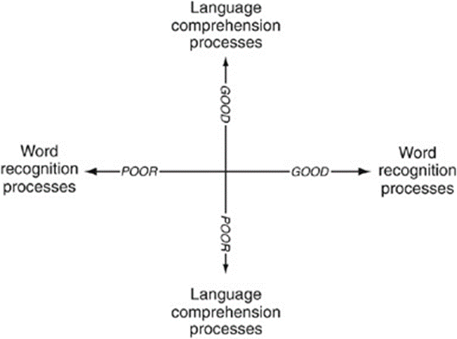
Step 3:
Indicate where each child is on the Simple View of Reading matrix from the evidence you have collected and explain your decision in a narrative. Explain why you have chosen the particular location in a quadrant where you have placed your focus child. Explain their strengths and areas for development as a reader, making reference to the evidence you have collected.
Figure from Gough, P.B. & Tunmer,W. E. (1986) Decoding, reading and reading disability. Remedial and Special Education, 7, 6-10.

Slide 10
Step 4:
Assess your focus children’s reading competencies using the EYFS or National Curriculum age-related expectations. You should also familiarise yourself with the school’s assessment system and may use this when carrying out your own assessment.
From your observations you made in steps 1-3 use this to assess each focus child’s attainment:
Use either the Development Matters for EYFS or Year Expectations from the National Curriculum
You can also use the CLPE Reading Scale
If the school uses a standardised reading test you may be able to conduct one
It may also be appropriate to assess their phonics knowledge by testing which sounds and words your focus children do know

Slide 11
Focus Children’s Progress Meeting – week 4
articulate your assessment of your focus children’s learning including strengths and areas for development
discuss with your mentor, setting small, next-step reading targets for each child
support the children to achieve these over the final two weeks of placement.
plan, prepare and deliver reading sessions that promote progress – these can be cross curricular
You will review the targets in your final week of placement

Slide 12
Where to record this task
Keep the observation notes/assessments, your reflections and any evidence of the children’s work on these tasks in your Planning and Assessment folder.
Summarise your observations and assessments in preparation for your Pupil Progress meeting in Week 4 using the PowerPoint template.

