Slide 1
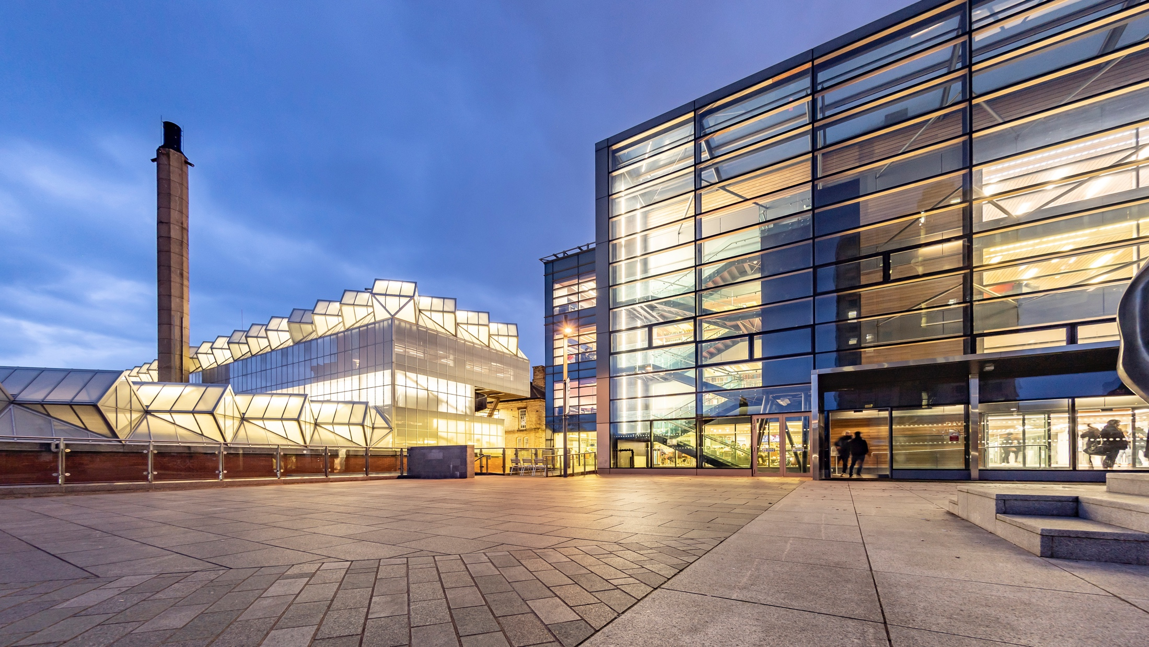
ITE Coordinator Conference
University of Leicester

Slide 2
Agenda
Welcome, Introductions
Delivery Grant Funding and Changes to Partnership Agreement for this year – Jenny Bosworth
Feedback from External Examiners
Curriculum Development focus: Education for Climate Change
Mentor training changes
Intensive Teaching and Practice Curriculum
Induction best practices.

Slide 3
Recruitment 2024-25
Total:
Core:
Lead Partner:
Mathematics
English
Science:
Humanities
MFL:

Slide 4
Updates - Jenny
General Mentor Delivery Grant
Changes to Partnership agreement (for this year)
Up to £876 (£43.80 per hour) — for schools outside London (the rest of England | Payments will be made in arrears based on the number of hours of training Schools will be able to claim this funding at the end of the 2024/25 academic year

Slide 5
School Experience website - Dan
new
https://pgce-school-experience.le.ac.uk/

Slide 6


Slide 7


Slide 8
Placements and Process - Dan
Outline of our system/Process
Discussion
What would help them as ITT co-ordinators?
How can we improve the process?
Challenges, support, timing?

Slide 9
Climate Change

Slide 10

Climate and Sustainability Education (CaSE)
Sheila Dennis and Adrian Warhurst

Slide 11

Notes:
Working in partnership with the UoR. Pilot 22/23

Slide 12

Notes:
Discuss DfE/national landscape.

Slide 13


Slide 14
Our approach to CaSE
Inspired by the positive outcomes from the University of Reading’s pilot 22/23, we have adopted the following approach:
Application of UoR’s CaSE curriculum framework
Climate Education/Climate Justice (Phase A teaching weeks)
Climate Action (Phase B teaching weeks)
CaSE Celebration (end of year)

Slide 15

Notes:
Critical discussions have taken place with student teachers about CaSE during Phase A teaching weeks.

Slide 16

Notes:
Students will consider Climate and Social Justice during Phase A teaching weeks.
Climate justice is a concept that addresses the ethical dimensions of climate change. It relates the causes and effects of climate change to concepts of justice, particularly environmental justice and social justice. Climate justice examines concepts such as equality, human rights, collective rights, and the historical responsibilities for climate change.

Slide 17


Slide 18
Discussion points
What does CaSE look like in your school/MAT?
How is CaSE integrated into subject curriculums? Examples?
What opportunities are there for student teachers to be involved in CaSE in subject/faculty/school/wider community?

Slide 19
Changes to admin

Slide 20
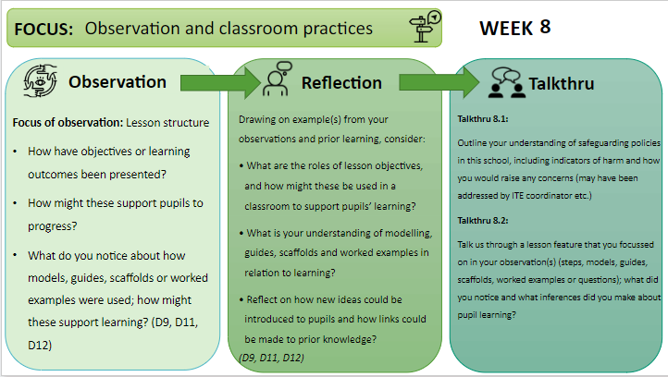
Tightened up the links between documents

Slide 21
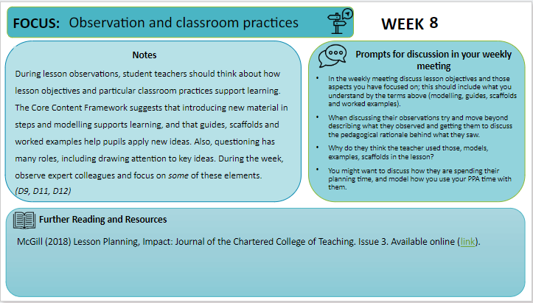

Slide 22



Weekly Meeting
Focused Observation
Reflection
Talkthru
Prompts
Informs

Slide 23
What does this mean for you?
Focused Observations
  Supporting mentors in identifying lessons outside of the subject to observe.
  Ensuring that PGCE students make the most of observing across the school
DISCUSSION: What are the barriers to PGCE students completing focused observations?
How can mentors be supported in this? Best practice ideas?

Slide 24
No more Eportfolios
All students will be submitting:
  Lesson Plan
  Weekly Meeting record
  Focused Observation
This will be done on Blackboard
They will have a onedrive for storing working documents to share with co-tutor

Slide 25
Mentor Training
Introduction to Mentoring
Phase Meetings
Overview of Programme
University Visit
CARD and Weekly Focus
1 hour (20 minute video plus optional reading)
4 hours
1 hour prepare
3 hours (Joint observation, mentoring discussion, feedback)
1 hour (20 minute video)
1.5 hours per phase
1.5 mentoring and curriculum review
10 hours
Linked to weekly focus

Slide 26
Structure
Programme Overview
Weekly updates
ITP
Placement
Introduction to Mentoring
Phase Meeting
University Visit

Slide 27
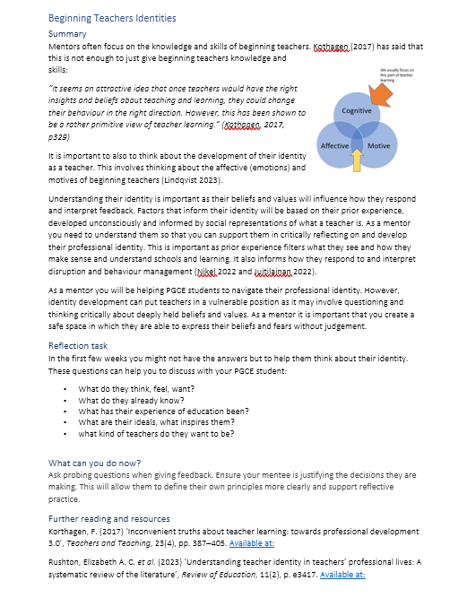
Drip fed training as part of weekly meeting
Short summaries
Optional additional reading
Will be included in weekly email with the Weekly Focus

Slide 28
ITP curriculum: professional noticing

Slide 29
Noticing
Deliberative and intentional
Interpretation
Deconstruct and analyse
Response
Decide on appropriate action based on interpretation
Principles and concepts in teaching used to interpret
Focused and prepared for
Based on principles, ideas and values of teaching.
Appropriateness of action determined in reference to teaching ideals, values, purposes.
Eg. Principles and theories of learning

Slide 30
Noticing
Interpreting
Response
The teacher asked questions
The teacher asked a range of questions of different levels of difficulty to a range of students chosen by the teacher
They did this to check if they knew the answer
Questioning might have used to involve students and challenge them or as formative assessment. The teacher selected students so everyone had to pay attention or they selected them so the right level of difficulty as a way of adapting their teaching.
If they answer incorrectly give them the correct answer
When a few students struggled they went over the content again. Just because one student gave correct answer not all might have understood so I would use another method to check understanding.

Slide 31
To use this professional noticing to inform pedagogical decisions that you make as a teacher.
To develop your ability to notice and reason about significant features of classroom situations.
ITP1 – Building relationships with students
Noticing student behaviour and teacher responses to this behaviour.
Know: Routines and how they are triggered.
Reflect: The purpose of routines in school and the role of routines within building relationships.
Doing: Developing routines and building relationships.
ITP2 – Understanding the school as a community
Noticing how the variety of students and adults contribute to different school cultures and classroom norms.
Know: School culture and classroom norms.
Doing: Professionalism and communicating high expectations for all.
ITP3 – Becoming an Inclusive Teacher
Noticing the hidden and visible barriers to learning in a classroom
Know: The barriers to inclusive teaching.
Doing: Planning and teaching so students can be included
ITP4 – Creativity and Engagement
ITP5 – Sequencing
Reflect: Who are the children you teach and who do you teach with.
Noticing engagement and emotions in a classroom.
Know: How do students engage emotionally with a learning activities.
Reflect: How learning resources, planning can influence emotional engagement
Doing: Planning for students emotions and engagement.
Reflect: Ways in which students are included and excluded within a classroom situation
Noticing where students are within a curriculum.
Know: What learners know and can do.
Reflect: Where the class is and their learning trajectory.
Doing: Moving from planning individual lesson to lesson sequences.
Developing Professional Noticing as a Teacher

Slide 32
ITP 2: Understanding the school as a community
Noticing how the variety of students and adults contribute to different school cultures and classroom norms.
Know: School culture and classroom norms.
Reflect: Who are the children you teach and who do you teach with.
Doing: Professionalism and communicating high expectations for all.

Slide 33
ITP 2 – 8th October
Activity 1: Join members of staff involved in the start of the day
Activity 2: School Treasure Hunt
Activity 3: Join a member of staff while on duty during either break or lunch duty
Activity 4: Observe a lesson in the school
This may have an impact on your induction activities. The aim is that they complement what you have planned for induction. The activities can be done across the 7th and 8th if it fits in with your induction timetable.

Slide 34
ITP5: Sequencing
Noticing where students are within a curriculum.
Know: What learners know and can do.
Reflect: Where the class is and their learning trajectory.
Doing: Moving from planning individual lesson to lesson sequences.

Slide 35
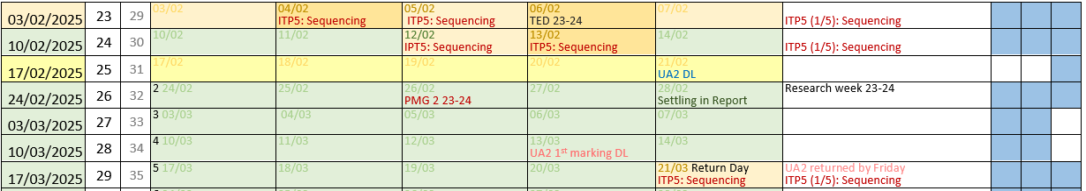
Key dates for you
Two days in the observation week are used for ITP5:
12th Jan – Observation
13th Jan – Returning to University

Slide 36

Rationale
Give the first week in school a tighter focus.
Get them to notice not just what lesson is being taught but where the students are in the curriculum

Slide 37
Activities
Observe a lesson then write a lesson plan for what they observed
Plan the next lesson based on what they have observed
Review schools Scheme of Work to look for links across topics, keystages, how do they build knowledge over
Observe a lesson – what do they notice about what the students know and can do from this lesson – how will this inform future planning

Slide 38
Induction

Slide 39
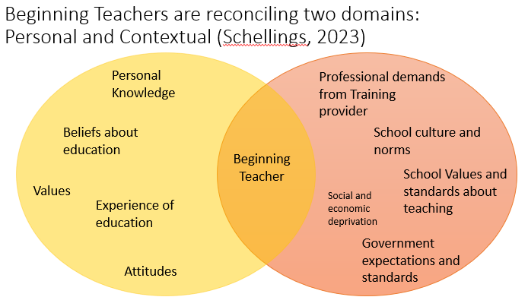
Discuss
How do you induct ITE students?
What works well?
How do they become aware of the school culture?
Why is it important to think about

Slide 40
Discuss
What do you do

