Slide 1
Mentor Development Meeting

Slide 2
Mentor Development
Introduction to Mentoring
Phase Meetings
Overview of Programme
University Visit
CARD and Weekly Focus

Slide 3
Structure
Programme Overview
Weekly updates
ITP
Placement
Introduction to Mentoring
Phase Meeting
University Visit

Slide 4
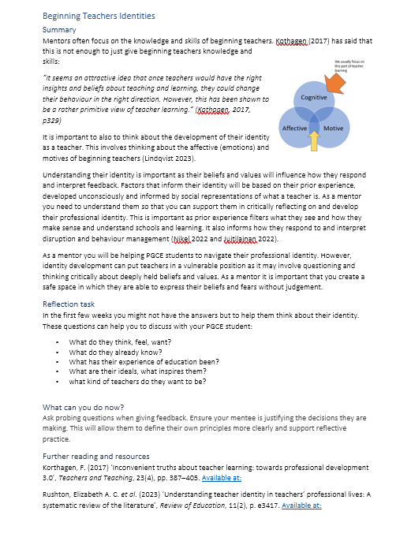
Drip fed training as part of weekly meeting
Short summaries
Optional additional reading
Will be included in weekly email with the Weekly Focus

Slide 5
Weekly Meeting
Focused Observation
Reflection
Talkthru
Prompts
Informs

Slide 6
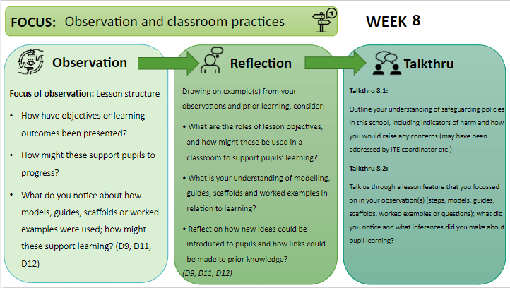
How they all fit together

Slide 8
What does this mean for you?
Focused Observations
Supporting mentors in identifying lessons outside of the subject to observe.
Ensuring that PGCE students make the most of observing across the school
DISCUSSION: What are the barriers to PGCE students completing focused observations?
How can mentors be supported in this? Best practice ideas?

Slide 9
No more Eportfolios
All students will be submitting:
Lesson Plan
Weekly Meeting record
Focused Observation
This will be done on Blackboard
They will have a onedrive for storing working documents to share with co-tutor

Slide 10
ITP curriculum: professional noticing
how professionals have capacity to make sense of what they observe in their everyday practice and use their understanding of what is being observed to make informed decisions about how to act within it.

Slide 11
Noticing
Deliberative and intentional
Interpretation
Deconstruct and analyse
Response
Decide on appropriate action based on interpretation
Principles and concepts in teaching used to interpret
Focused and prepared for
Based on principles, ideas and values of teaching.
Appropriateness of action determined in reference to teaching ideals, values, purposes.
Eg. Principles and theories of learning

Slide 12
Noticing
Interpreting
Response
The teacher asked questions
The teacher asked a range of questions of different levels of difficulty to a range of students chosen by the teacher
They did this to check if they knew the answer
Questioning might have used to involve students and challenge them or as formative assessment. The teacher selected students so everyone had to pay attention or they selected them so the right level of difficulty as a way of adapting their teaching.
If they answer incorrectly give them the correct answer
When a few students struggled they went over the content again. Just because one student gave correct answer not all might have understood so I would use another method to check understanding.

Slide 13
To use this professional noticing to inform pedagogical decisions that you make as a teacher.
To develop your ability to notice and reason about significant features of classroom situations.
ITP1 – Building relationships with students
Noticing student behaviour and teacher responses to this behaviour.
Know: Routines and how they are triggered.
Reflect: The purpose of routines in school and the role of routines within building relationships.
Doing: Developing routines and building relationships.
ITP2 – Understanding the school as a community
Noticing how the variety of students and adults contribute to different school cultures and classroom norms.
Know: School culture and classroom norms.
Doing: Professionalism and communicating high expectations for all.
ITP3 – Becoming an Inclusive Teacher
Noticing the hidden and visible barriers to learning in a classroom
Know: The barriers to inclusive teaching.
Doing: Planning and teaching so students can be included
ITP4 – Creativity and Engagement
ITP5 – Sequencing
Reflect: Who are the children you teach and who do you teach with.
Noticing engagement and emotions in a classroom.
Know: How do students engage emotionally with a learning activities.
Reflect: How learning resources, planning can influence emotional engagement
Doing: Planning for students emotions and engagement.
Reflect: Ways in which students are included and excluded within a classroom situation
Noticing where students are within a curriculum.
Know: What learners know and can do.
Reflect: Where the class is and their learning trajectory.
Doing: Moving from planning individual lesson to lesson sequences.
Developing Professional Noticing as a Teacher

Slide 14
ITP 2: Understanding the school as a community
Noticing how the variety of students and adults contribute to different school cultures and classroom norms.
Know: School culture and classroom norms.
Reflect: Who are the children you teach and who do you teach with.
Doing: Professionalism and communicating high expectations for all.

Slide 15
Pick 5 bricks that represent your first experience of teaching

Slide 16
Pick 10 bricks and build a model

Slide 17
Explain how this model represents a beginning teacher.

Slide 18
Build a model that represents a challenge you might face as a mentor

Slide 19
Build a model that represents the challenges a beginning teacher might face

Slide 20
Build a model that represents what a good mentor

Slide 21
