Slide 1
Phase 1 Focus Children Progress Summary
Insert Name

Slide 2
Phase 1 Focus Children Progress Summary
Insert Name

Slide 3
School and Class Context
 | School | Class | England
Total number of pupils |  |  | 4727089
Girls on roll |  |  | 49%
Boys on roll |  |  | 51%
Pupils with an SEN EHCP |  |  | 1.6%
Pupils with SEN Support |  |  | 12.6%
Pupils whose first language is not English |  |  | 21.2%
Pupils eligible for free school meals at any time during the past 6 years |  |  | 23%
Find out your school’s information here
Ask your teacher mentor to provide you with your class data
Write a short summary of how your school, class and national data compare.

Slide 4
Overview of Children
 | Gender | Age | First Language | Pupil Premium | Likes | Dislikes | What helps them to learn in school?
Child A
Child B
Child C SEND need:

Slide 5
Reading

Slide 6
Reading: Prior Attainment
 | EYFS Baseline | End of EYFS (Literacy) | Year 1 | Phonics Audit | Year 2 | Year 3 | Year 4 | Year 5
Child A |  | Emerging / expected / exceeding | Working towards/ working at ARE/ greater depth | Score: Working at / working below | Working towards/ working at ARE/ greater depth | Working towards/ working at ARE/ greater depth | Working towards/ working at ARE/ greater depth | Working towards/ working at ARE/ greater depth
Child B |  | Emerging / expected / exceeding | Working towards/ working at ARE/ greater depth | Score: Working at / working below | Working towards/ working at ARE/ greater depth | Working towards/ working at ARE/ greater depth | Working towards/ working at ARE/ greater depth | Working towards/ working at ARE/ greater depth
Child C |  | Emerging / expected / exceeding | Working towards/ working at ARE/ greater depth | Score: Working at / working below | Working towards/ working at ARE/ greater depth | Working towards/ working at ARE/ greater depth | Working towards/ working at ARE/ greater depth | Working towards/ working at ARE/ greater depth
NB If the school uses different terminology, please use the school’s system

Slide 7
Reading: Child A/B/C
You may like to include
Pupil voice (relevant quotes)
Extracts reading journals/diaries
Book reviews
Phonic sound/word checks
You should provide evidence you conducted a miscue
Here you should write a short summary of what you have learnt about the child’s readings skills highlighting strengths and areas for development.

Slide 8
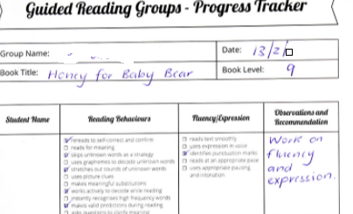
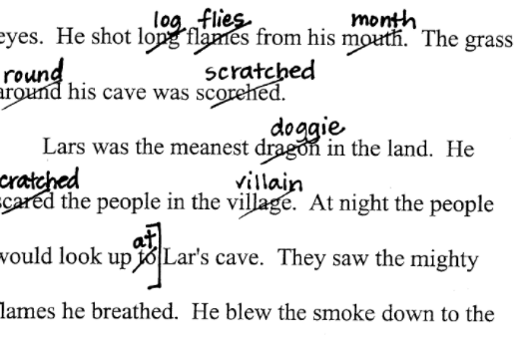
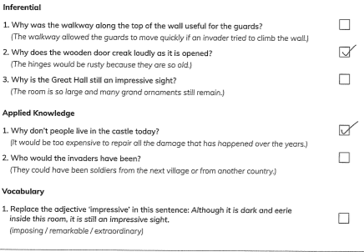
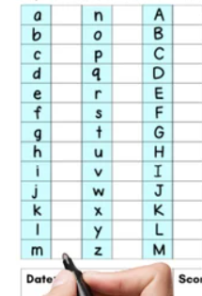
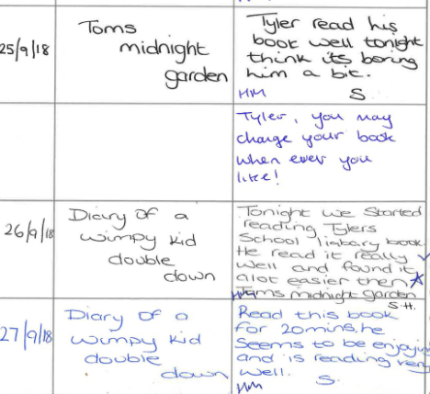
Examples of Evidence
Reading logs
Miscue
Reading comprehension task
Sounds check
Questions to check understanding

Slide 9
Simple View of Reading
Good
Language comprehension processes
On the matrix indicate where you would place your focus children on the SVR and provide a short summary of your rationale for this
Poor
Word reading processes
Good
Word reading processes
Poor
Language comprehension processes

Slide 10
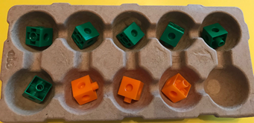
Counting and calculation
6 + 3 = 9

Slide 11
Mathematics: Prior Attainment
 | EYFS Baseline | End of EYFS (Mathematics) | Year 1 | Year 2 | Year 3 | Year 4 | Year 5
Child A |  | Emerging / expected / exceeding | Working towards/ working at ARE/ greater depth | Working towards/ working at ARE/ greater depth | Working towards/ working at ARE/ greater depth | Working towards/ working at ARE/ greater depth | Working towards/ working at ARE/ greater depth
Child B |  | Emerging / expected / exceeding | Working towards/ working at ARE/ greater depth | Working towards/ working at ARE/ greater depth | Working towards/ working at ARE/ greater depth | Working towards/ working at ARE/ greater depth | Working towards/ working at ARE/ greater depth
Child C |  | Emerging / expected / exceeding | Working towards/ working at ARE/ greater depth | Working towards/ working at ARE/ greater depth | Working towards/ working at ARE/ greater depth | Working towards/ working at ARE/ greater depth | Working towards/ working at ARE/ greater depth
NB If the school uses different terminology, please use the school’s system

Slide 12
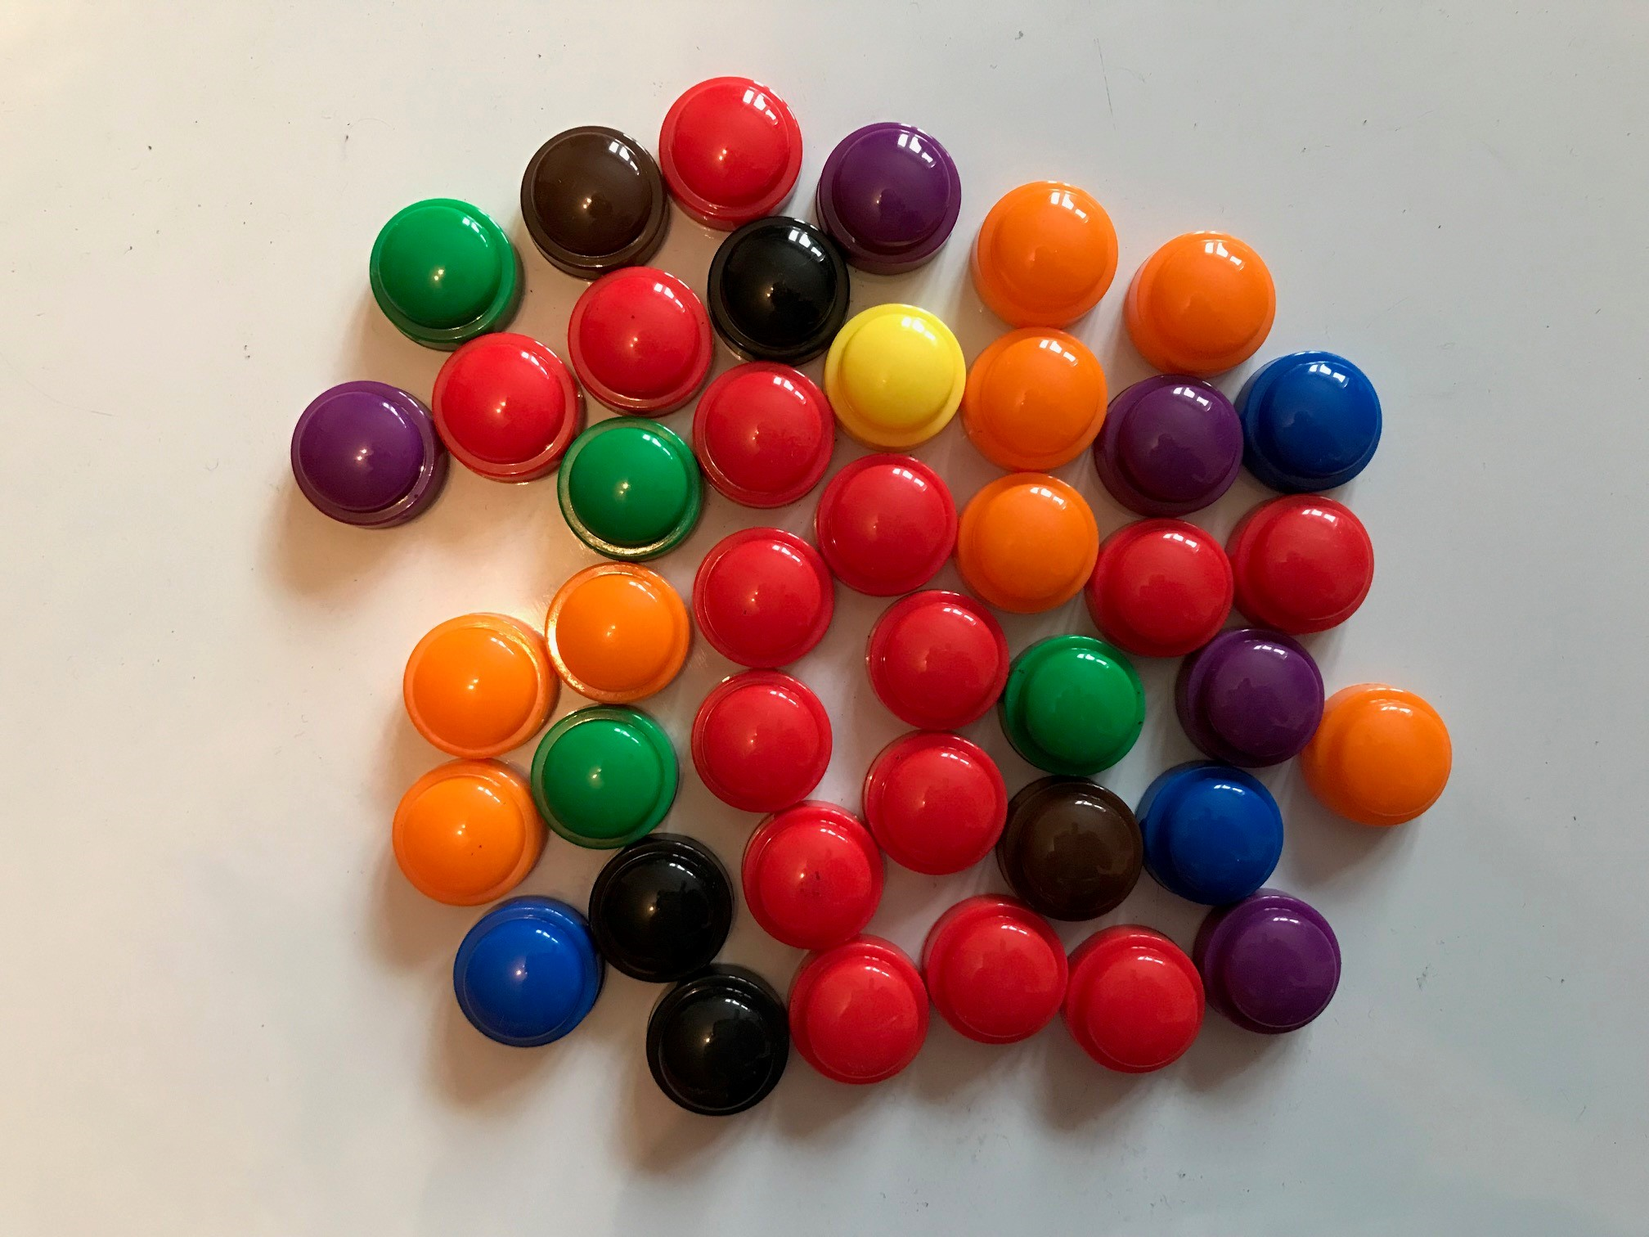
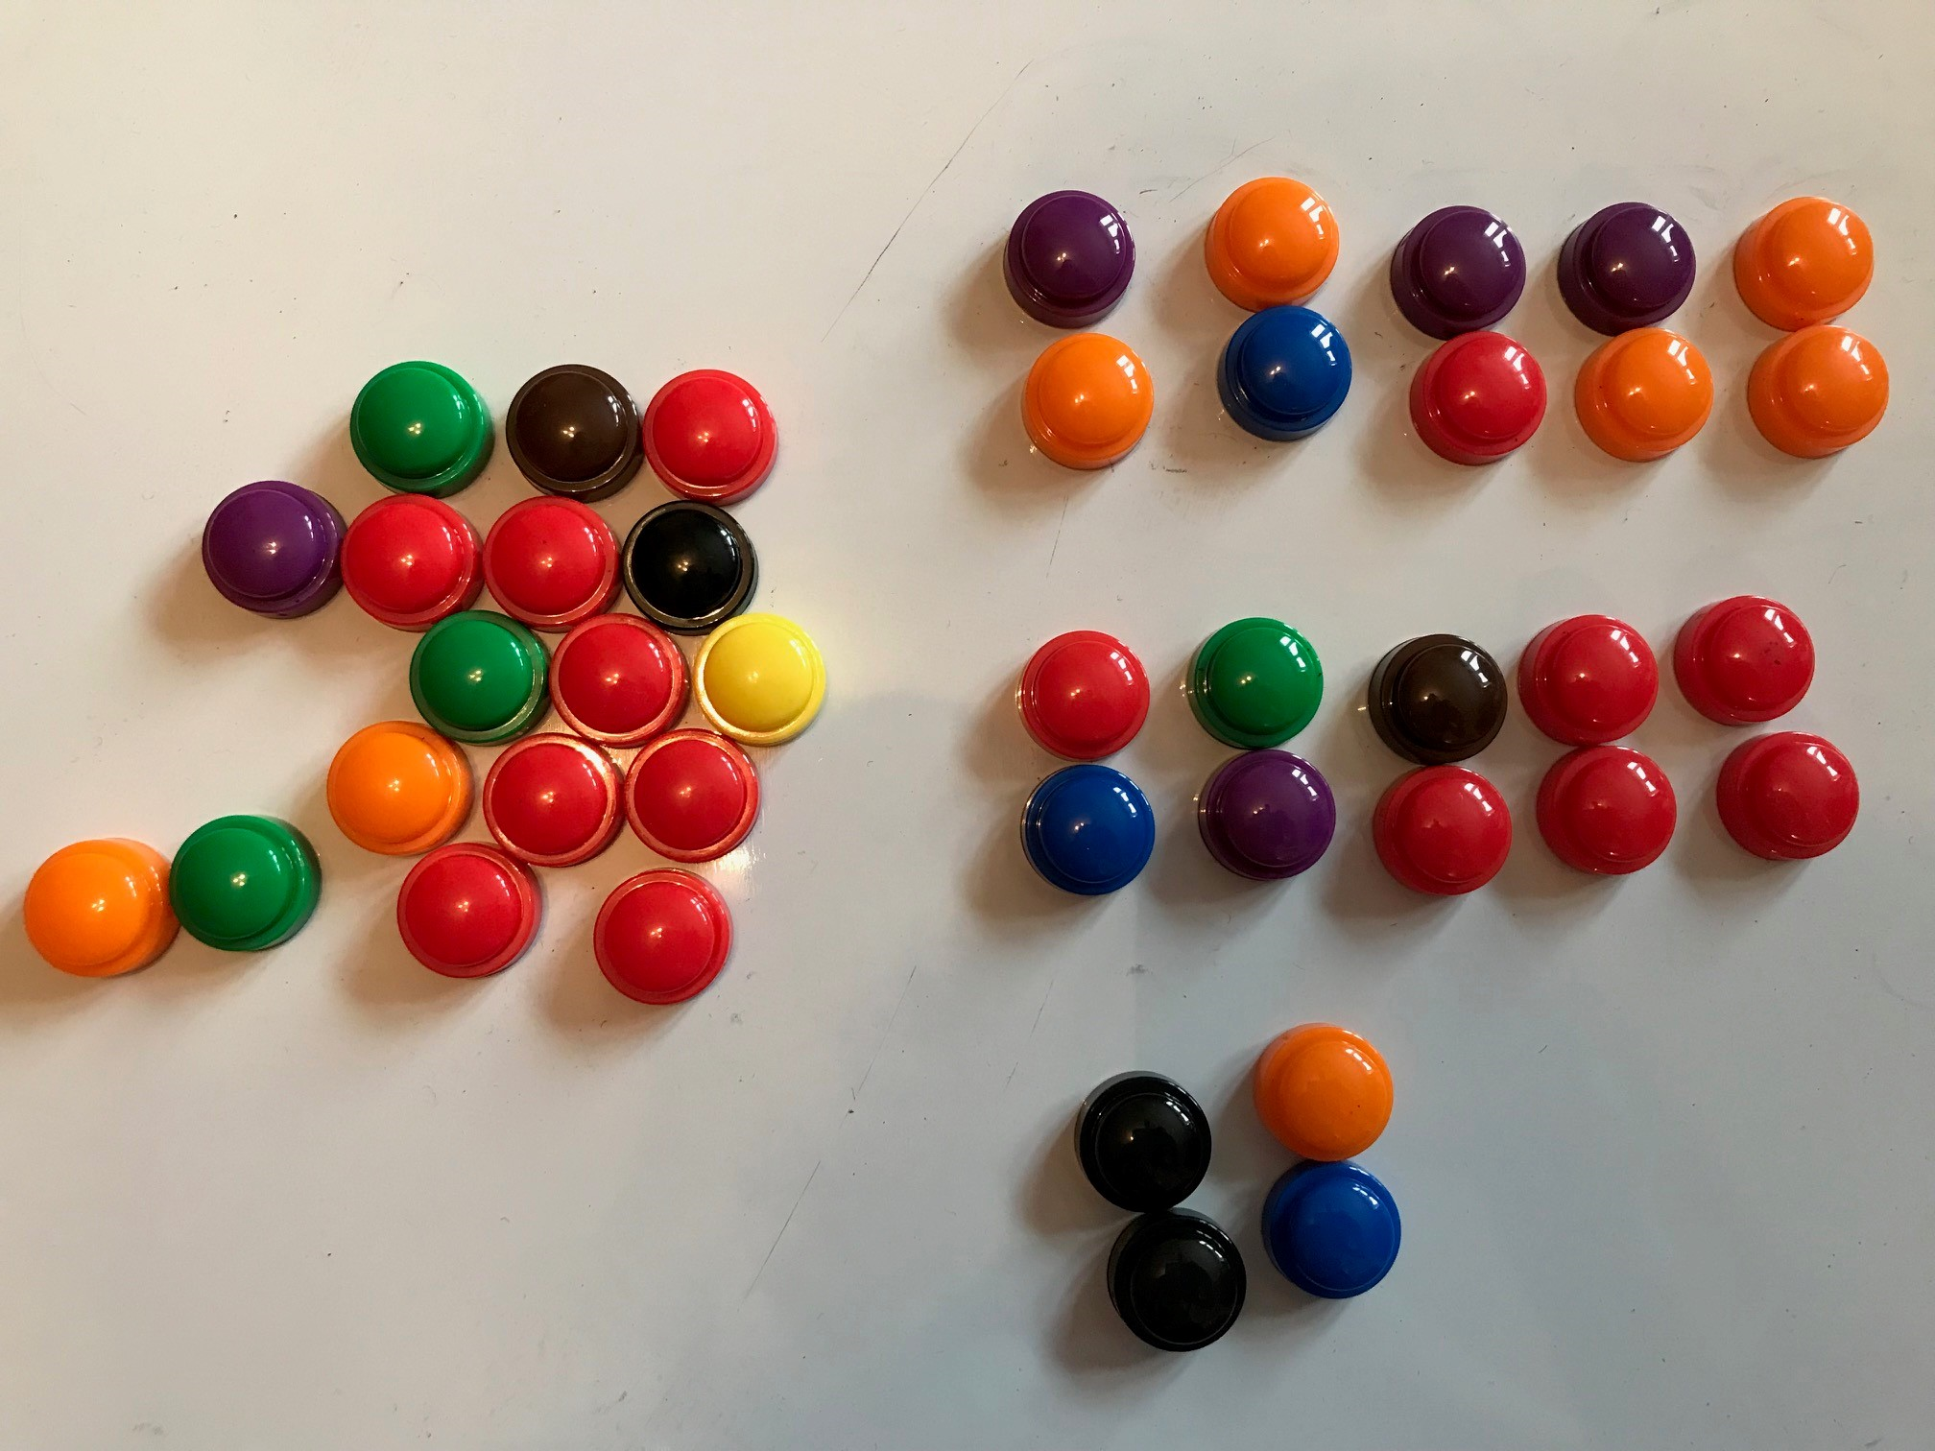
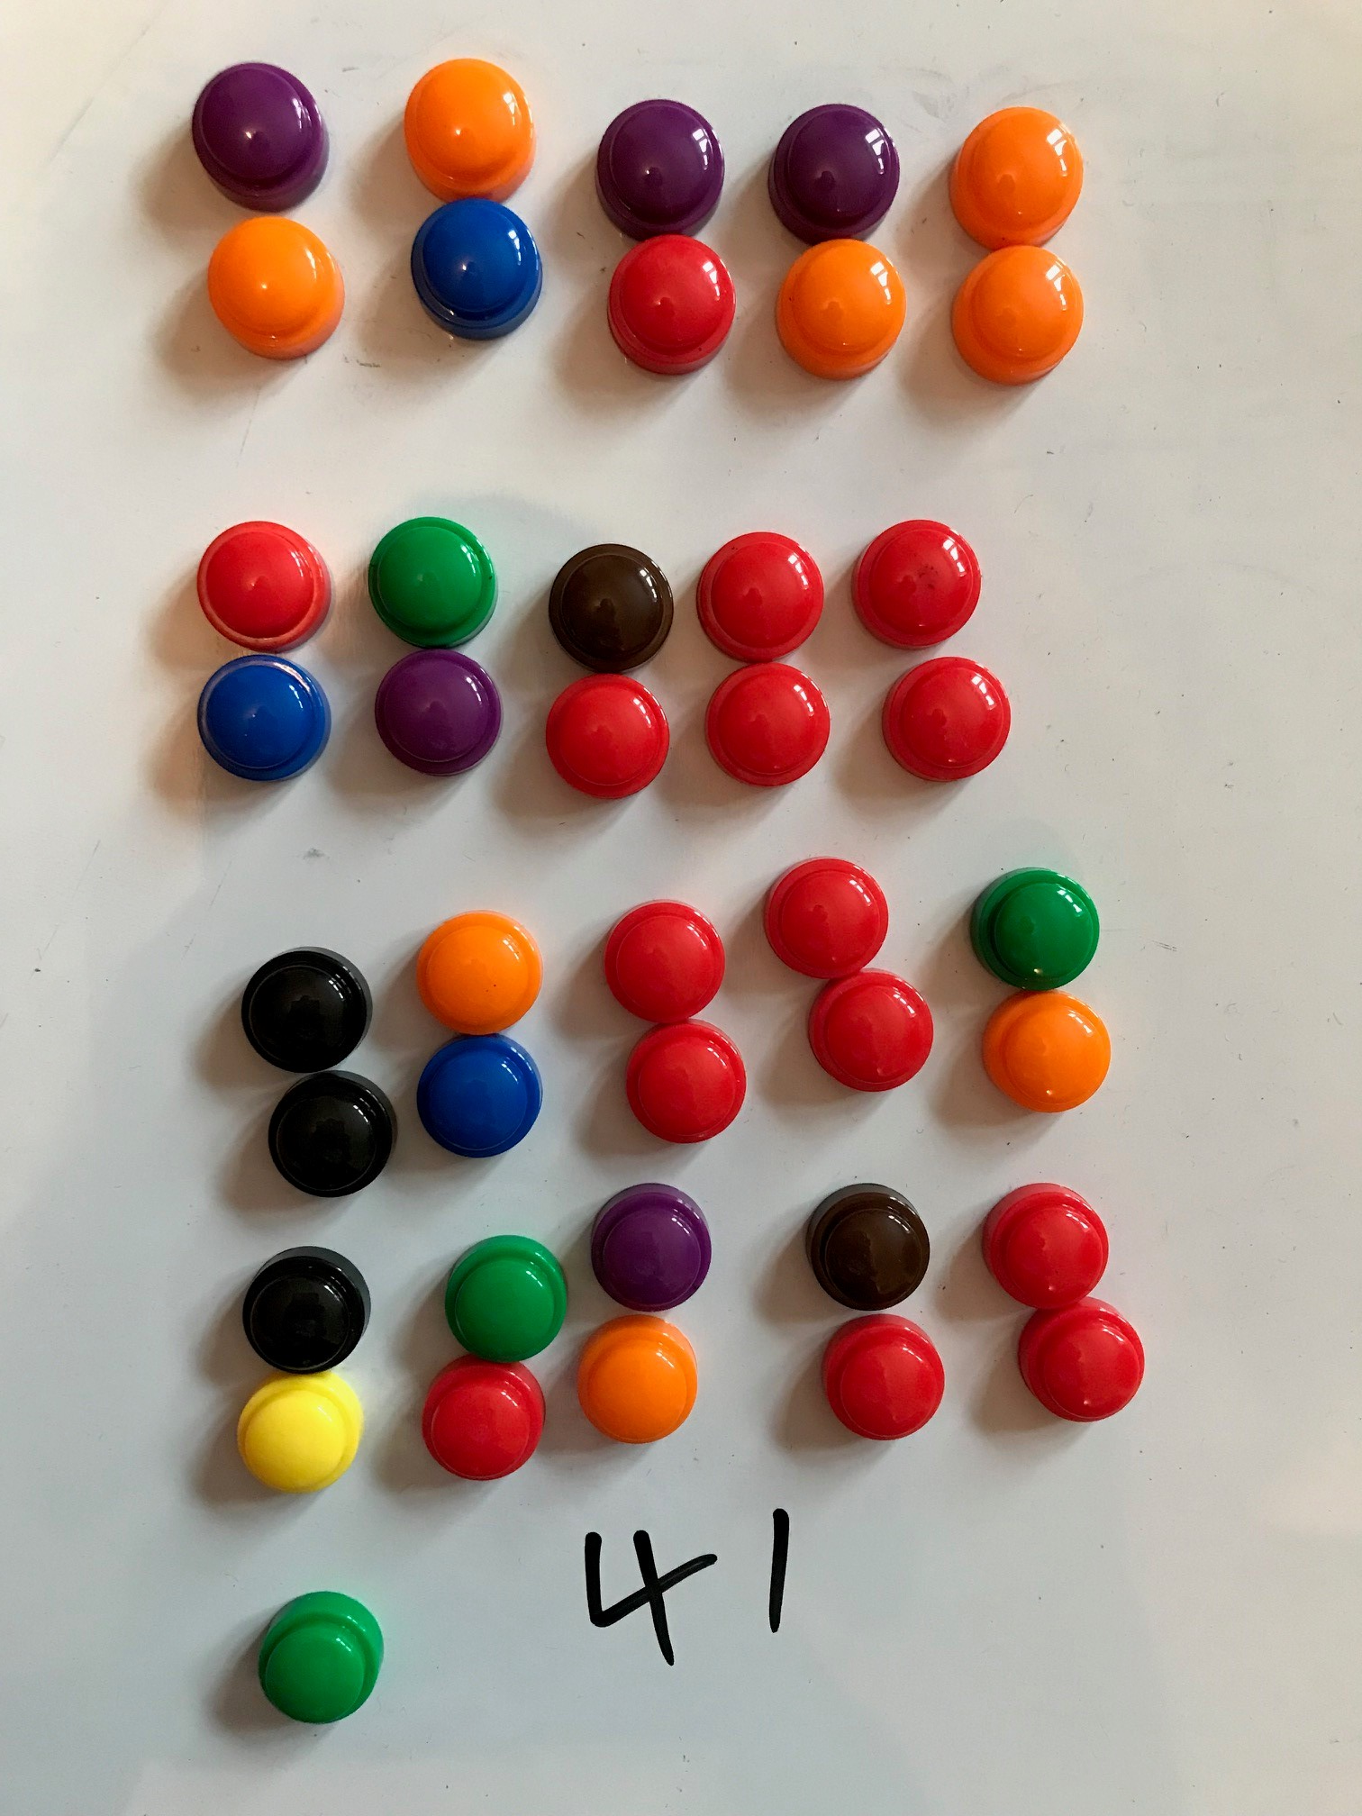
Counting and Calculation: Child A/B/C
Here you should write a short summary of what you have learnt about the child’s counting and calculation skills
You may like to include
Pupil voice (relevant quotes)
Extracts of activity sheets
Photos e.g.
e.g. counted in ones to start with. When prompted to try counting in 2s created groups of 10 and then counted the tens.
Notes:
Example of using photos with counting

Slide 13
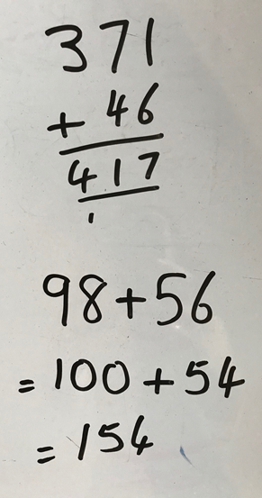
Examples of Evidence
e.g. counted in ones to start with. When prompted to try counting in 2s created groups of 10 and then counted the tens.
Notes:
Example of using photos with counting

Slide 14
Scientific Concepts
Working scientifically
14

Slide 15
Science/Understanding the World: Prior Attainment
 | EYFS Baseline | End of EYFS (Understanding the World) | Year 1 | Year 2 | Year 3 | Year 4 | Year 5
Child A |  | Emerging / expected / exceeding | Secure/Not Secure | Secure/Not Secure | Secure/Not Secure | Secure/Not Secure | Secure/Not Secure
Child B |  | Emerging / expected / exceeding | Secure/Not Secure | Secure/Not Secure | Secure/Not Secure | Secure/Not Secure | Secure/Not Secure
Child C |  | Emerging / expected / exceeding | Secure/Not Secure | Secure/Not Secure | Secure/Not Secure | Secure/Not Secure | Secure/Not Secure
NB If the school uses different terminology, please use the school’s system

Slide 16
Scientific Concepts: Child A/B/C
Here you should write a short summary of what you have learnt about the child’s understanding of floating sinking (e.g. what do they know and might they need to know next) and what did you do to challenge their thinking
You may like to include
Pupil voice (relevant quotes)
Extracts of activities sheets e.g. results chart
Children’s drawing

Slide 17
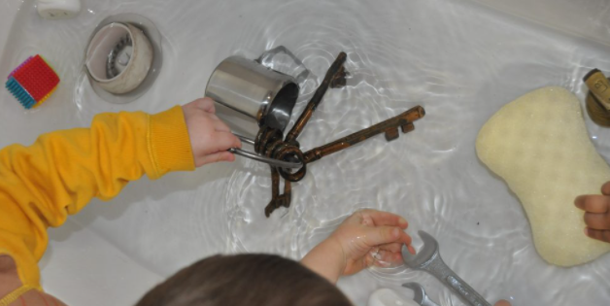
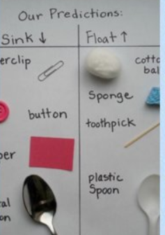
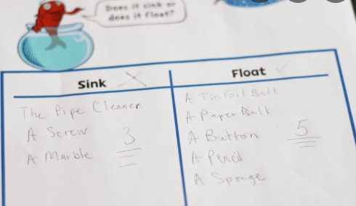
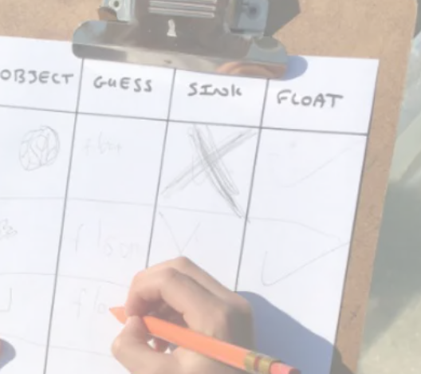
Examples of Evidence

Slide 18
Focus Children’s Working Scientifically Skills
What did you see and hear that indicated that the children were behaving like scientists e.g. predicting, observing, measuring, recording, concluding?

Slide 19
Next steps:
With your teacher mentor agree how you might support your focus children’s learning in reading, counting and calculation and scientific concepts during week 5 and 6
 | Reading | Counting and Calculation | Scientific Concepts
Child A
Child B
Child C

