Slide 1
ITP 5: Noticing where students are within a curriculum.

Slide 2
What this ITP will help develop
Builds understanding of:
What the class needs
How to sequence learning
How to respond adaptively during lessons
Anticipate the next logical steps in learning
Pitch lessons appropriately
Avoid teaching content pupils already know
Avoid advancing before pupils are ready
Enables smoother transition into teaching responsibilities during the first weeks of placement

Slide 3
ITP1 – Building relationships with students
ITP2 – Understanding the school as a community
ITP3 – Becoming an Inclusive Teacher
ITP4 – Creativity and Engagement
ITP5 – Sequencing
Developing Professional Noticing as a Teacher

Slide 4
Noticing where students are within a curriculum.
Know: What learners know and can do.
Reflect: Where the class are and their learning trajectory.
Doing: Moving from planning individual lesson to lesson sequences.

Slide 5

You will inherit classes mid‑sequence
Pupils have:
  Established routines
  Partially learned concepts
  Upcoming assessment demands

Slide 6
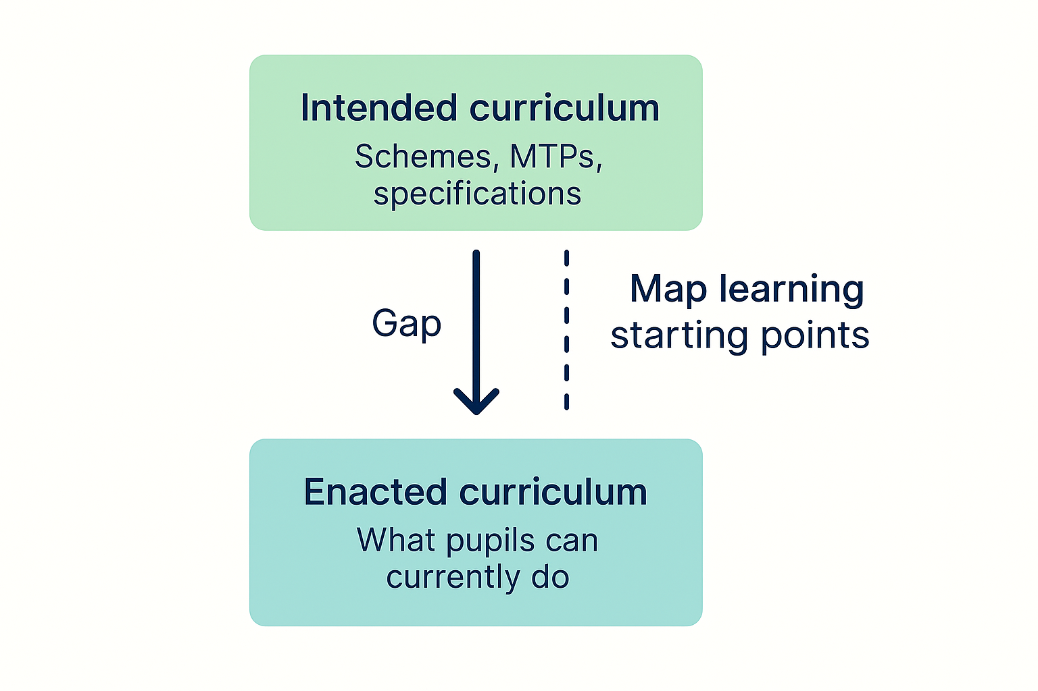
Curriculum‑Aligned Noticing
A crucial dimension of professional noticing
Locates learners within a curriculum sequence
Situates observations within a progression of knowledge and skills
Recognises that learning is cumulative, building on secure foundations

Slide 7

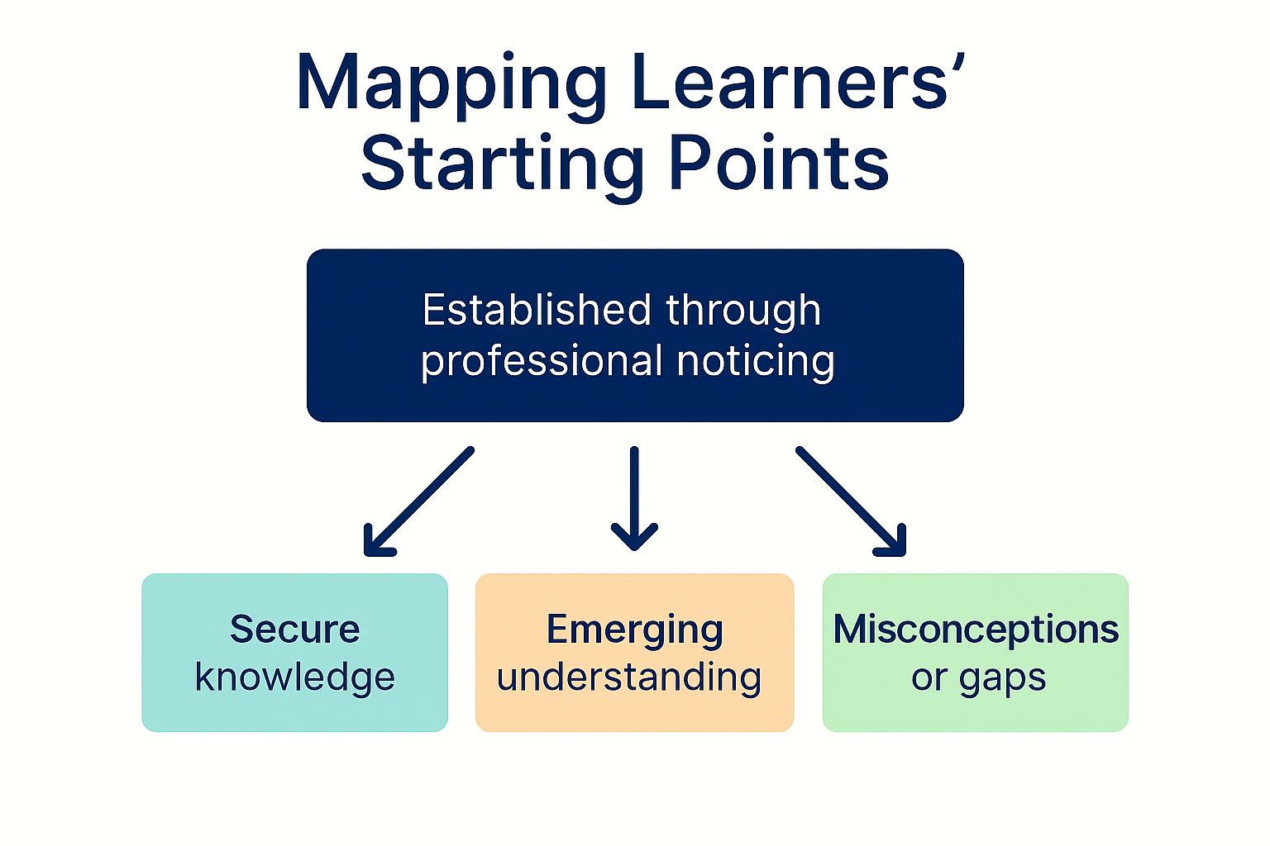

Slide 8
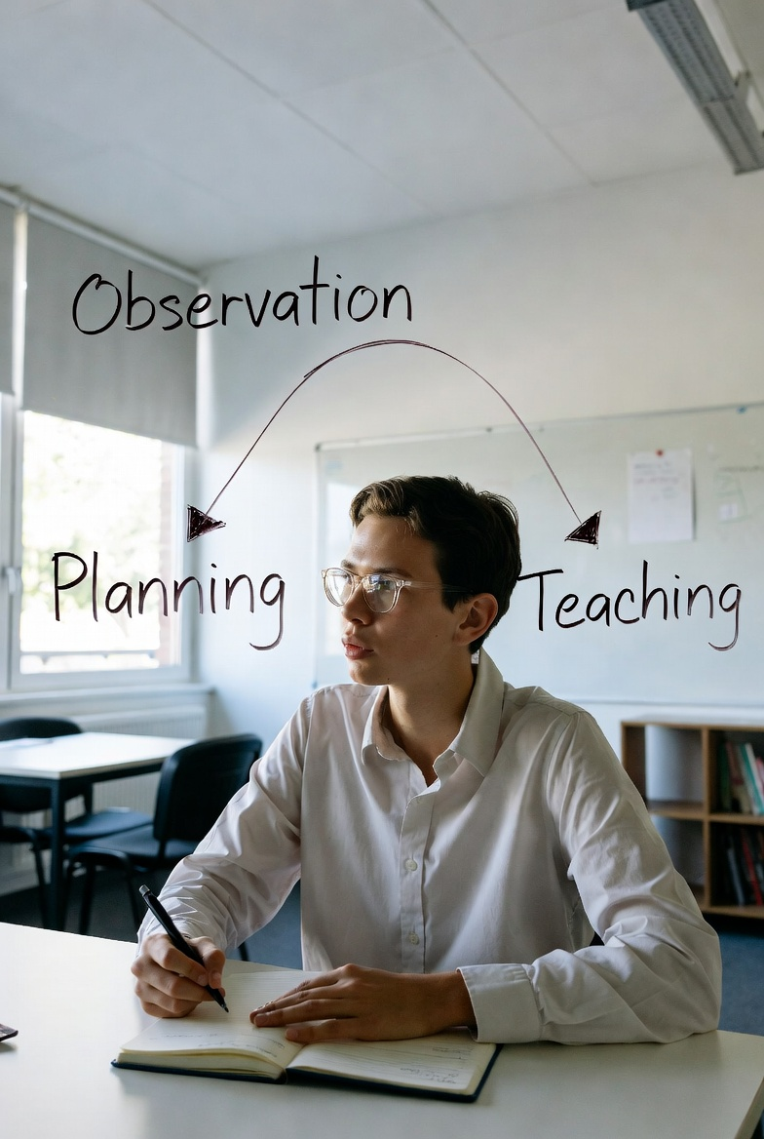
Why noticing where students are in the curriculum is important
Bridges between planning, teaching and learning.
Helps maintain logical progression across lessons
Strengthens alignment between:
  Intended curriculum
  Taught curriculum
  Learned curriculum

Slide 9
1. Notice
Explore curriculum documents
Observe
2. Interpret
Compare the intended curriculum with what you observed in lesson.
Discuss with your mentor
3. Response
Identify the next steps in the sequence
Plan a sequence of Lessons
Look at a sequence of learning

Slide 10
What you will do in week 1
Map the intended curriculum (schemes, MTPs, specifications)
Compare it to the enacted curriculum (what pupils can currently do)
Understand the learning trajectory the class is on
Noticing links classroom observation → planning → teaching
Use this to plan the taught curriculum through a outline of a sequence of lessons.

