Slide 1

Phase B Mentor Training 5th Feb 26 Kerry Onyejekwe and Jake Halford

Slide 2
Agenda
School experience website
Important dates
Mentor training
Weekly Meeting
Student Blackboard
Focused observations
ITP 5 – Sequencing
Placement requirements
Teachers’ Standards report and PPC report
Cause for concern

Slide 3

Website
https://pgce-school-experience.le.ac.uk/

Slide 4
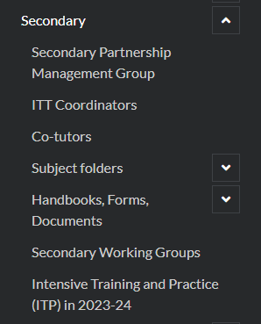
Website
Recordings of Meetings
Curriculum materials
CARD A and B with subject exemplification
Course Calendar
Practicum Guides
ERFs (teaching and ‘other’)
Commendation Form
Support Plan/ Action Plan forms
Please have a go at accessing the website now
https://pgce-school-experience.le.ac.uk/

Slide 5
Training Material On the Website
We will briefly introduce these areas in this meeting but videos that explain them in greater depth are on school experience website.
Overview of Course
Phase B Assessment
Weekly Focus and Weekly Meetings
Cause for Concern
Timetables and planning
Mentor development guides

Slide 6
Important Dates
Settling in Report
27th Feb
Interim Report
26th March
Teachers’ Standards Report
22nd May
Final PPC Report
19th June
ITE Coordinator completes
Are they on track to meet the teaching standards?
Have they met the teachers’ standards?
Have they continued to met professional and personal conduct standards until the end of placement?
Have they settled into the placement?
Last week of Placement

Slide 7

Drip fed training as part of weekly meeting
Short summaries
Optional additional reading
Will be included in weekly email with the Weekly Focus

Slide 8



Weekly Meeting
Focused Observation
Reflection
Talkthru
Prompts
Informs

Slide 9
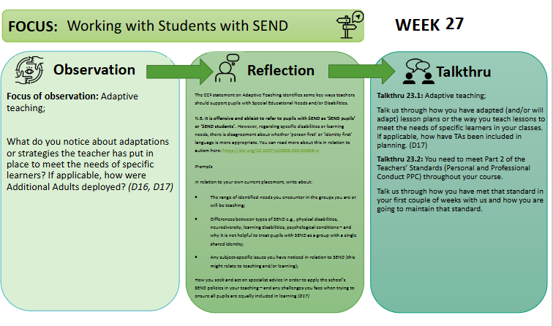
How they all fit together

Slide 10
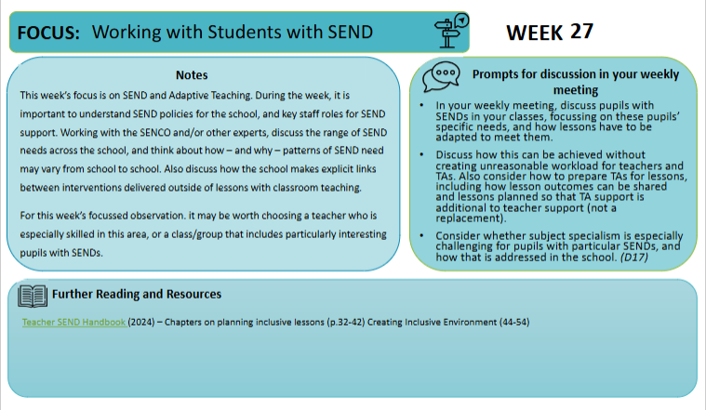

Slide 11
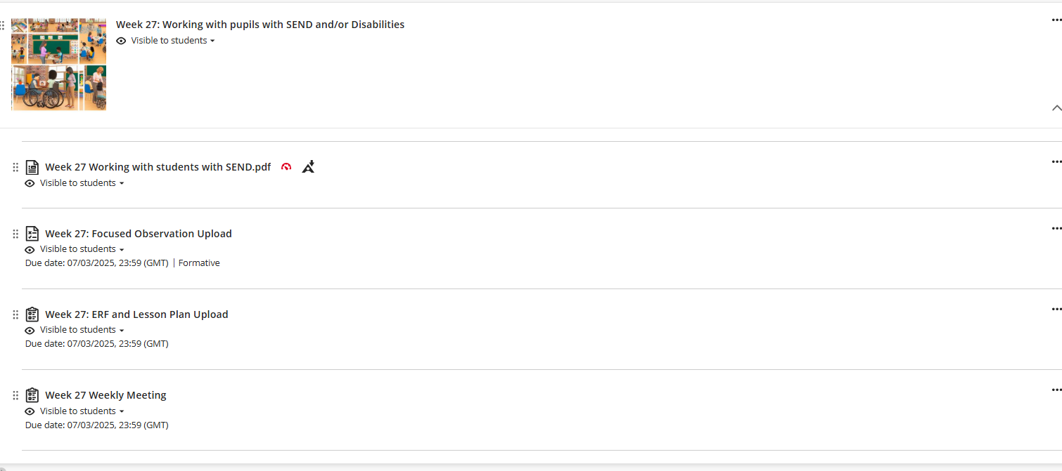
What the student see's on BB

Slide 12
Importance of Focused Observations
Supporting mentors in identifying lessons outside of the subject to observe.
Ensuring that PGCE students make the most of observing across the school

Slide 13
No more Eportfolios
All students will be submitting one per week:
Lesson Plan
Weekly Meeting record
Focused Observation
This will be done on Blackboard (slide 11)
They will have a onedrive for storing working documents

Slide 14
ITP curriculum: professional noticing
how professionals have capacity to make sense of what they observe in their everyday practice and use their understanding of what is being observed to make informed decisions about how to act within it.

Slide 15
To use this professional noticing to inform pedagogical decisions that you make as a teacher.
To develop your ability to notice and reason about significant features of classroom situations.
ITP1 – Building relationships with students
Noticing student behaviour and teacher responses to this behaviour.
Know: Routines and how they are triggered.
Reflect: The purpose of routines in school and the role of routines within building relationships.
Doing: Developing routines and building relationships.
ITP2 – Understanding the school as a community
Noticing how the variety of students and adults contribute to different school cultures and classroom norms.
Know: School culture and classroom norms.
Doing: Professionalism and communicating high expectations for all.
ITP3 – Becoming an Inclusive Teacher
Noticing the hidden and visible barriers to learning in a classroom
Know: The barriers to inclusive teaching.
Doing: Planning and teaching so students can be included
ITP4 – Creativity and Engagement
ITP5 – Sequencing
Reflect: Who are the children you teach and who do you teach with.
Noticing engagement and emotions in a classroom.
Know: How do students engage emotionally with a learning activities.
Reflect: How learning resources, planning can influence emotional engagement
Doing: Planning for students emotions and engagement.
Reflect: Ways in which students are included and excluded within a classroom situation
Noticing where students are within a curriculum.
Know: What learners know and can do.
Reflect: Where the class is and their learning trajectory.
Doing: Moving from planning individual lesson to lesson sequences.
Developing Professional Noticing as a Teacher

Slide 16
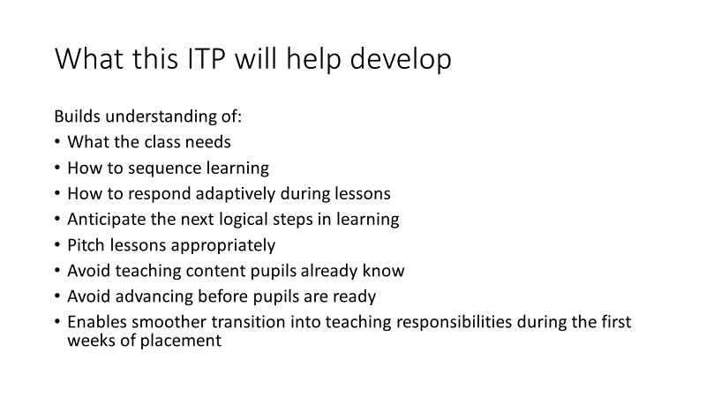
ITP 5 - Sequencing

Slide 17
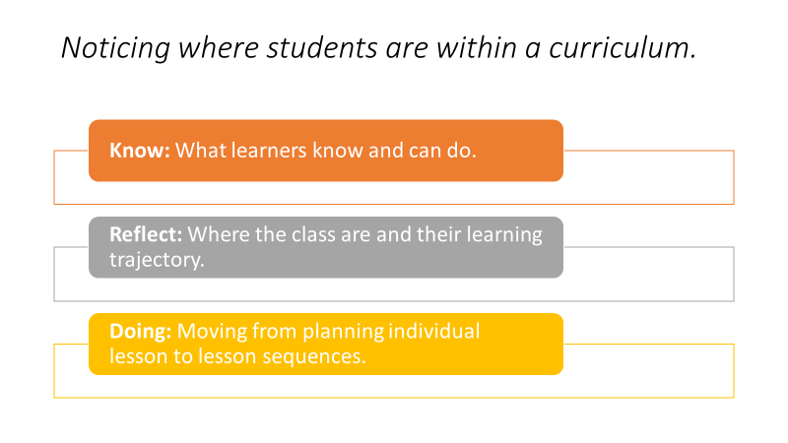

Slide 18
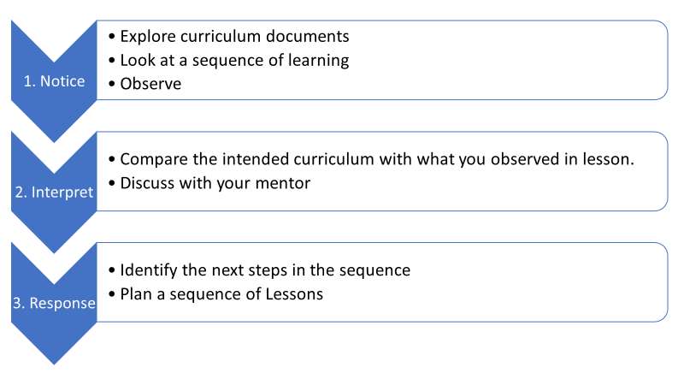
ITP 5 what students will be doing

Slide 19
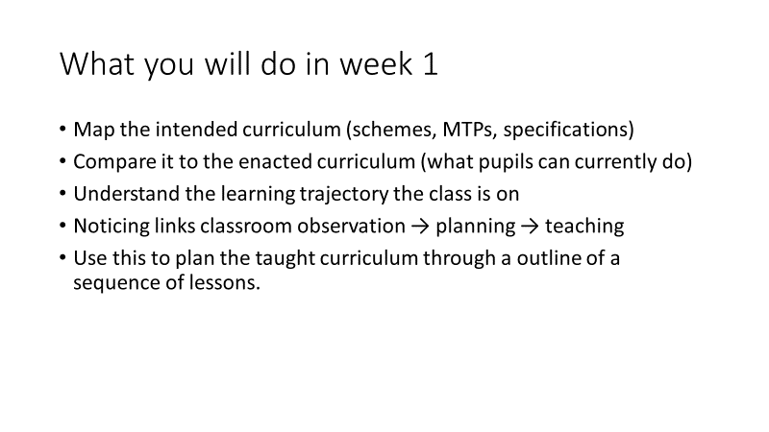
ITP 5 – What students will be doing

Slide 20
Support from Mentor
1. Before the ITP Begins: Prepare Key Information
Provide essential curriculum materials
Give the student teacher access to:
Medium-Term Plans (MTPs) for the class
Current scheme of work / unit overviews
Assessment information
Any departmental guidance on progression or key misconceptions

Slide 21
2. Arrange structured time for the student teacher to observe one of their timetabled classes after they have looked at the curriculum documents.
Provide a brief class profile
Ensure the student teacher has the contextual knowledge they need to interpret what they observe meaningfully. Include:
Key SEND/EAL considerations
Attainment patterns
Students who were previously struggling or excelling
Before this observation, prompt the student teacher to notice:
What knowledge appears secure
What learners recall or struggle with
Common misconceptions
Variation across the class

Slide 22
3. After Observation: Discuss What Was Noticed (Reflect)
Meet with the student teacher for 10–15 minutes to discuss:
What they noticed about where students are in the curriculum
How this compares to where the MTP says they should be
Emerging misconceptions or gaps
What prior knowledge appears strong or weak
How learners’ current understanding affects the next steps
Use prompts such as:
What surprised you?
What patterns did you notice?
“What do you think learners are ready for next?

Slide 23
4. Planning Support: Guide Them to Shape a Mini Sequence (Doing)
The student teacher will now draft a 3–5 lesson mini sequence based on their noticing. In your first weekly meeting discuss the mini-sequence.
Check for:
A clearly stated sequence intention (what the lessons aim to achieve)
Logical progression from lesson to lesson
Clear connections to curriculum expectations
Anticipated misconceptions
Planned Checks for Understanding (CfU) in each lesson
Appropriate pitch for the class
Provide constructive feedback
Focus on:
Whether the sequence follows a coherent learning trajectory
Whether the pitch matches the class’s current level
Opportunities to strengthen modelling, scaffolding, or practice
Ensure that each lesson builds on the last and supports the next.

Slide 24
Teaching timetable
Increased from Phase A
Two thirds of an ECT timetable
More involvement with pastoral role/ form tutor/ PSHE
3 Lesson Day | 15 possible lessons | ECT teaches 12 | Student teacher teachers 8
5 lesson day | 25 possible lessons | ECT teaches 20 | Student teacher teaches 13
6 lesson day | 30 possible lessons | ECT teaches 24 | Student teacher teaches 15/16
8 lesson day | 40 possible lessons | ECT teaches 32 | Student teacher teaches teach 21
Notes:
For schools with 100 min lessons/ 140 min lessons – work it out!

Slide 25
Opportunity for 6 weeks at ECT timetable
DfE requirement to offer the opportunity for 6 weeks of an ECT timetable (20 hours)
Only if student is progressing as they should be
Can be any time in the placement
Does not have to be consecutive
Can be observations, team teaching or full teaching
Preparing for progress on to ECT

Slide 26
Phase B school placement
Make sure your student teacher receives Safeguarding/ Child Protection policy
Ensure that they have access to SEND information and know who the SENDCO is in the school.
First week for Phase B – ITP5, mostly observe and get to know classes
Take on classes more quickly than in Phase A (discuss with your student teacher)
Student teachers need to keep up to date with the ‘paperwork’,
Student teachers have been told to find out and adhere to school’s absence policy and let university know if absent.

Slide 27
Change to reports
The Teachers’ Standards report is not the final report anymore
It shows they have met most of the teachers’ standards
The PPC report is when they have met all of the teaching standards and PPC
Settling in Report
27th Feb
Interim Report
26th March
Teachers’ Standards Report
22nd May
Final PPC Report
19th June
ITE Coordinator completes
Are they on track to meet the teaching standards?
Have they met the teachers’ standards?
Have they continued to met professional and personal conduct standards until the end of placement?
Have they settled into the placement?
Last week of Placement

Slide 28
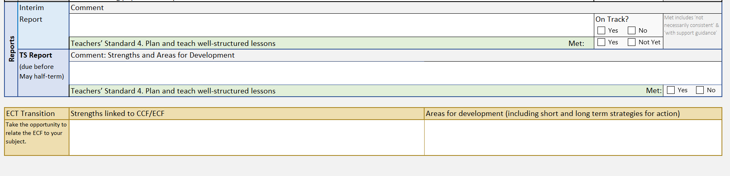
Teachers’ Standards Report

Slide 29
What does it mean to have met the teachers’ standard?
Met: A student teacher secure in each of the associated TS Benchmark Statements will have met that particular Teachers’ Standard (for trainees).
In broad terms, for ‘met’, the student teacher will be meeting the TS Benchmark Statements much of the time in most contexts, but this may not be consistently sustained across a range of contexts, and support and guidance (S&G) appropriate for a student teacher may be needed.
Assessment should be in context not ‘ECT’ standards

Slide 30

Final PPC report
In the final week of placement you will make a final judgement on if the student teacher has met PPC and Teaching Standard 8.
Unlike other teaching standards the student teacher must be secure and consistently demonstrating personal and professional conduct.

Slide 31
Reasons for concern
Student is underperforming (e.g., not making progress, lack of awareness of shortcomings)
Not responding to feedback (e.g., student is making the same mistakes)
Personal Issues (e.g., Mental health, personal circumstances)
Professionalism (e.g., relationships, attendance, punctuality, communication)

Slide 32
What to do if you have a concern?
Inform your ITE Coordinator and University Subject Tutor
You are not expected to undertake and address these concerns without support.
As a mentor there is a range of support for you and the student teacher are entitled to use and some conversations fall outside of the boundaries of a mentor-mentee relationship and in those circumstances
You should direct your student teacher to other people or organisations.
The most common occurrence is relating to students wellbeing and mental health.
Yours is not a counselling role, and students can seek support from the university, through their personal tutor and by accessing further support, detailed on : https://le.ac.uk/study/wellbeing.

Slide 33
Safeguarding and Wellbeing
Head of Course: headsec@leicester.ac.uk
Concerned: concerned@le.ac.uk
Welfare: https://reportandsupport.le.ac.uk/
Standing Together: standingtogether@le.ac.uk
Safeguarding Lead:
Jenny Bosworth jb591@leicester.ac.uk

Slide 34
Questions?

Slide 35
Thank you for attending
Recording will be available
Slides on School Experience website
Please get in touch
You should be getting Weekly emails the first one being tomorrow by 3pm – if you do not receive it please email Secpgce and we will ensure you are on the email list. It is important that you get these weekly emails

