Slide 1
Phase 1 Focus Children Progress Summary
Insert Name

Slide 2
Overview of Children
 | Gender | Age | First Language | Pupil Premium | Likes | Dislikes | What helps them to learn in school?
Child A
Child B
Child C
Child D SEND need:

Slide 3

Reading

Slide 4
Reading: Child A
Include a short summary of what you have learnt from observations / assessment including examples of evidence

Slide 5
Reading: Child B
Include a short summary of what you have learnt from observations / assessment including examples of evidence

Slide 6
Reading: Child C
Include a short summary of what you have learnt from observations / assessment including examples of evidence

Slide 7
Reading: Child D
Include a short summary of what you have learnt from observations / assessment including examples of evidence

Slide 8
Simple View of Reading (Child A/B/C)
Good
Language comprehension processes
On the matrix indicate where you would place your focus children on the SVR and provide a short summary of your rationale for this
Poor
Word reading processes
Good
Word reading processes
Poor
Language comprehension processes

Slide 9

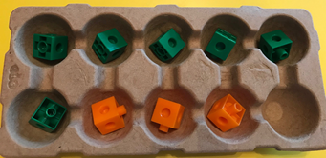
Counting and calculation
6 + 3 = 9

Slide 10
Counting and Calculating: Child A
Include a short summary of what you have learnt from observations / assessment including examples of evidence

Slide 11
Counting and Calculating: Child B
Include a short summary of what you have learnt from observations / assessment including examples of evidence

Slide 12
Counting and Calculating: Child C
Include a short summary of what you have learnt from observations / assessment including examples of evidence

Slide 13
Counting and Calculating: Child D
Include a short summary of what you have learnt from observations / assessment including examples of evidence

Slide 14
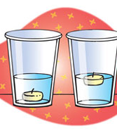
Scientific Concepts
Working scientifically

Slide 15
Scientific Concepts: Child A
Include a short summary of what you have learnt from observations / assessment including examples of evidence

Slide 16
Scientific Concepts: Child B
Include a short summary of what you have learnt from observations / assessment including examples of evidence

Slide 17
Scientific Concepts: Child C
Include a short summary of what you have learnt from observations / assessment including examples of evidence

Slide 18
Scientific Concepts: Child D
Include a short summary of what you have learnt from observations / assessment including examples of evidence

Slide 19
Focus Children’s Working Scientifically Skills
What did you see and hear that indicated that the children were behaving like scientists e.g. predicting, observing, measuring, recording, concluding?

Slide 20
Next steps:
With your teacher mentor agree how you might support your focus children’s learning in reading, counting and calculation and scientific concepts during weeks 7 to 10.
 | Reading | Counting and Calculation | Scientific Concepts or skills
Child A
Child B
Child C
Child D

